Slide 1

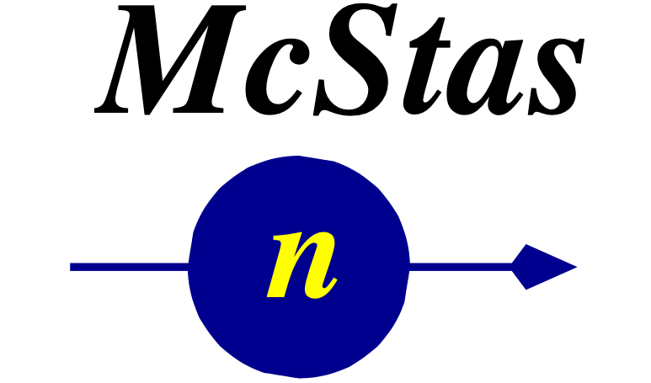




Neutron optics
Peter Willendrup, DTU Physics & ESS DMSC
- And thanks to Ken Andersen ESS for letting me use a lot of his slides on guides!

Slide 2
Neutron optics - subtopics
Key properties of the neutron
Transporting the beam
Neutron guides and how they work
Tailoring the beam
Spatially
Directionally
Temporally
Energetically

Slide 3
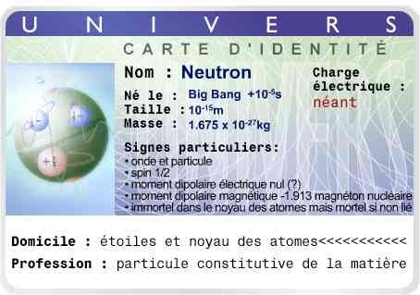
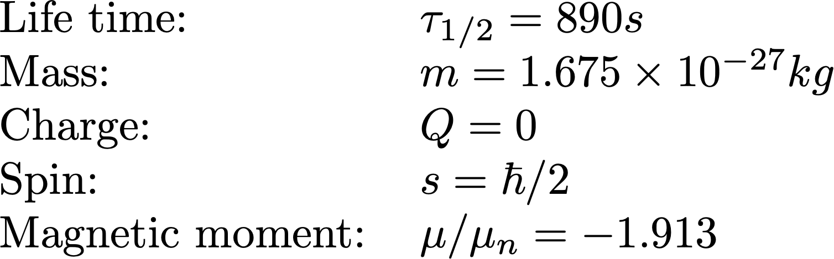
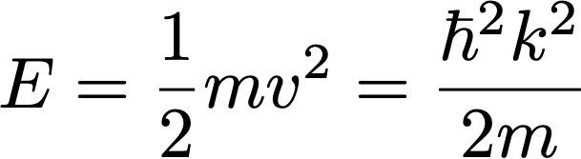
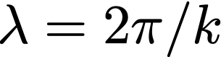

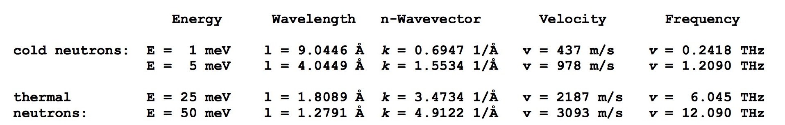
The neutron - a reminder
,
Mr. Neutron

Slide 4
The neutron - a reminder
,
Mr. Neutron

Slide 5
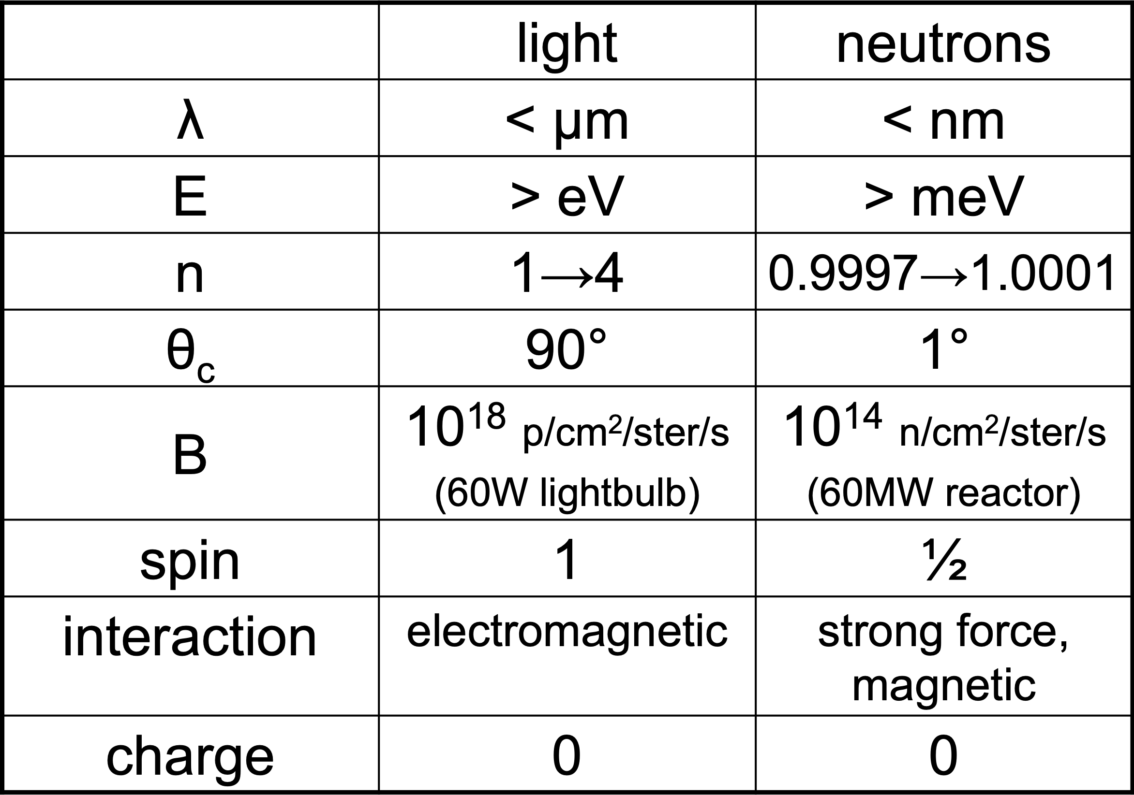
Optical properties - slow neutrons vs. light

Slide 6

Optical properties - slow neutrons vs. light
Corresponding to distances and excitations within condensed matter
Neutrons are scarce, but we have a chance to transport them

Slide 7
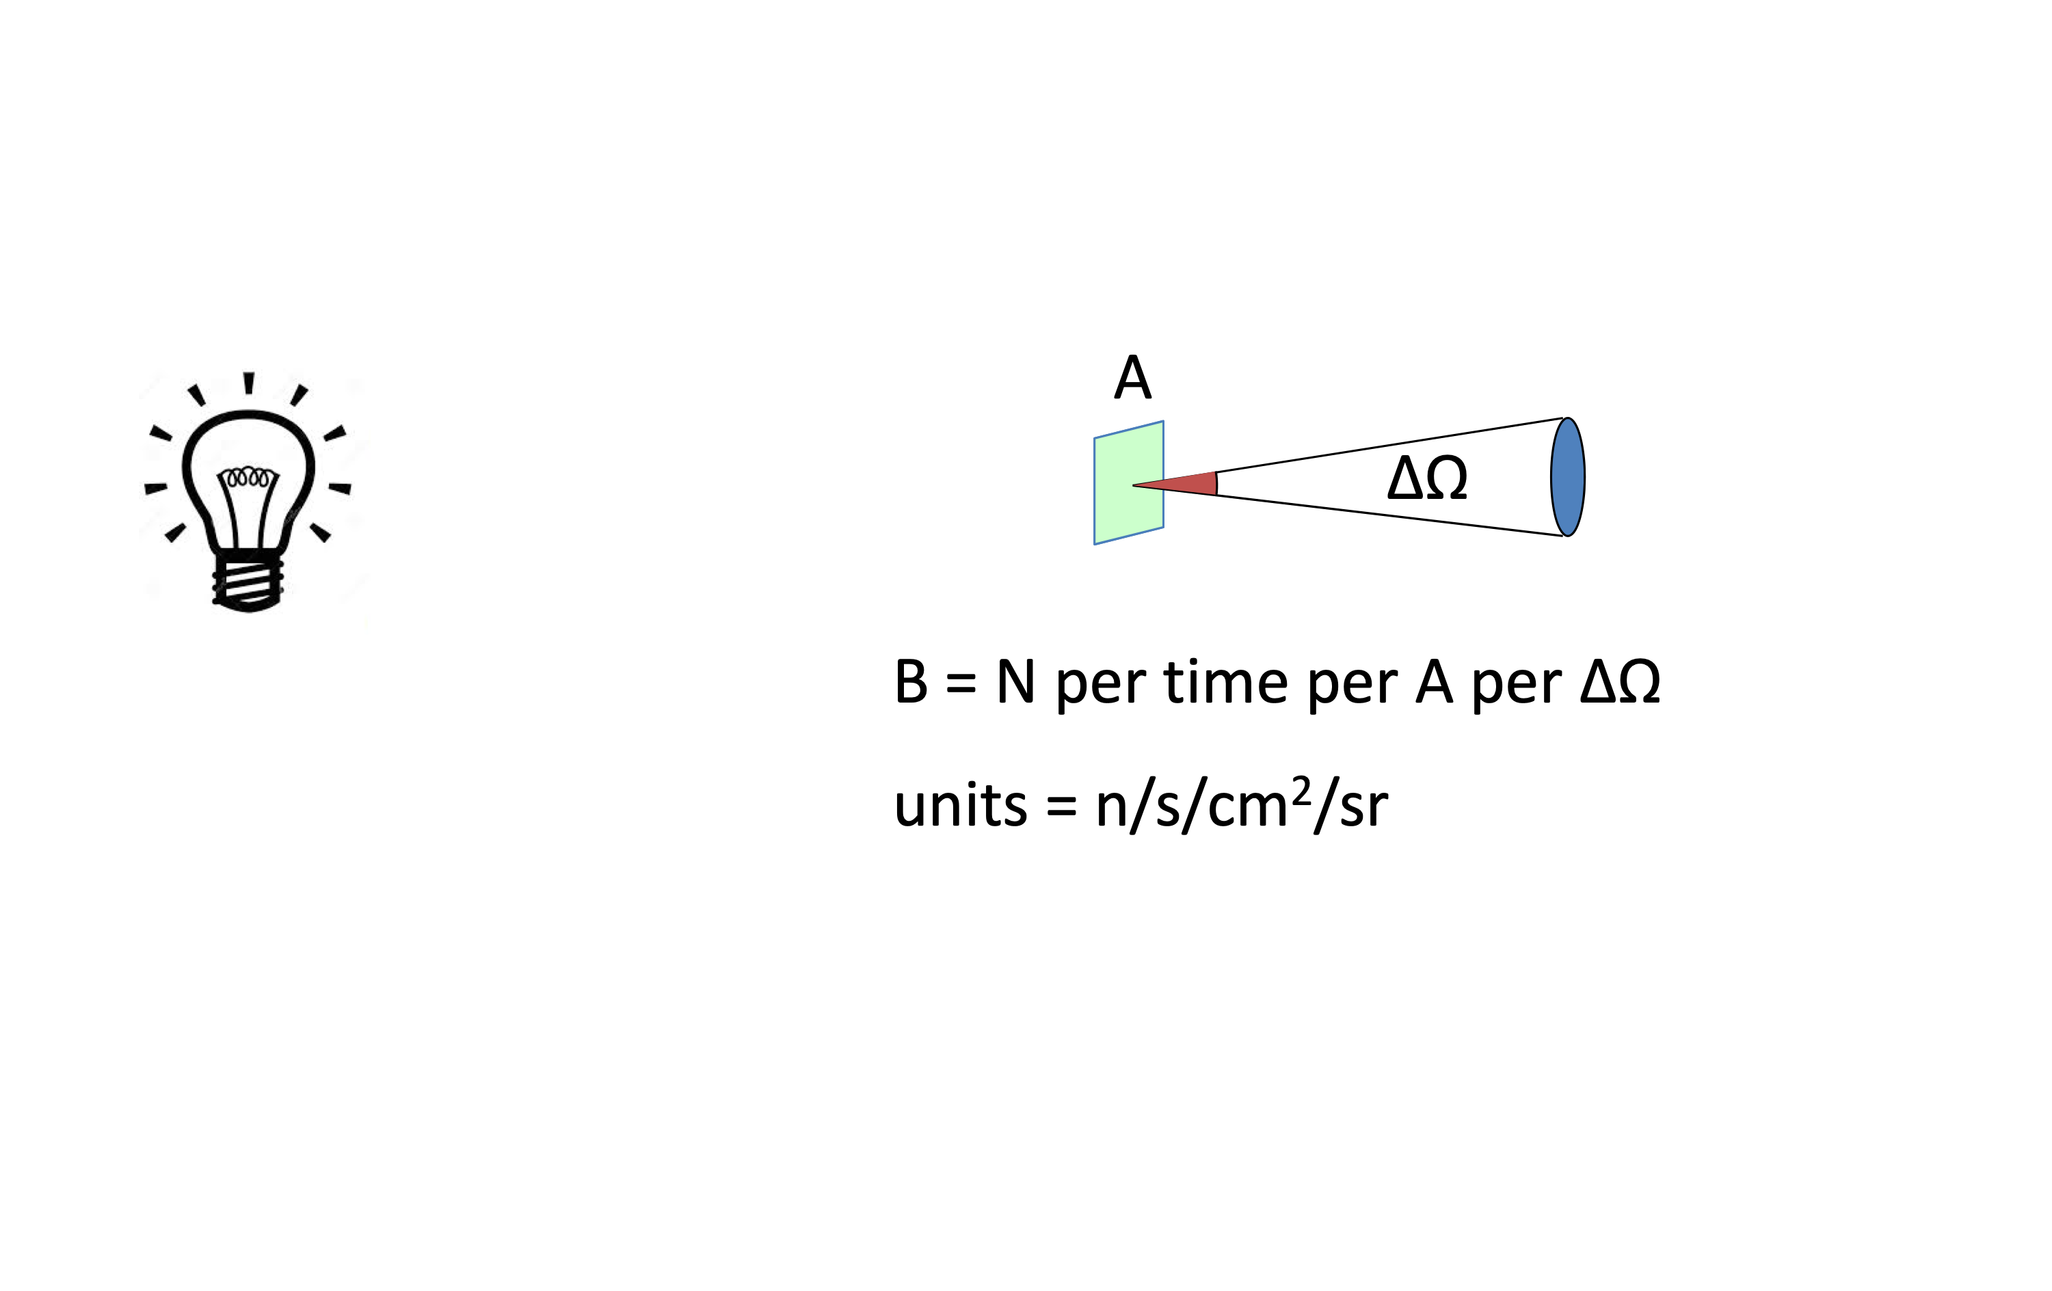
Neutron flux - and brilliance / brightness

Slide 8
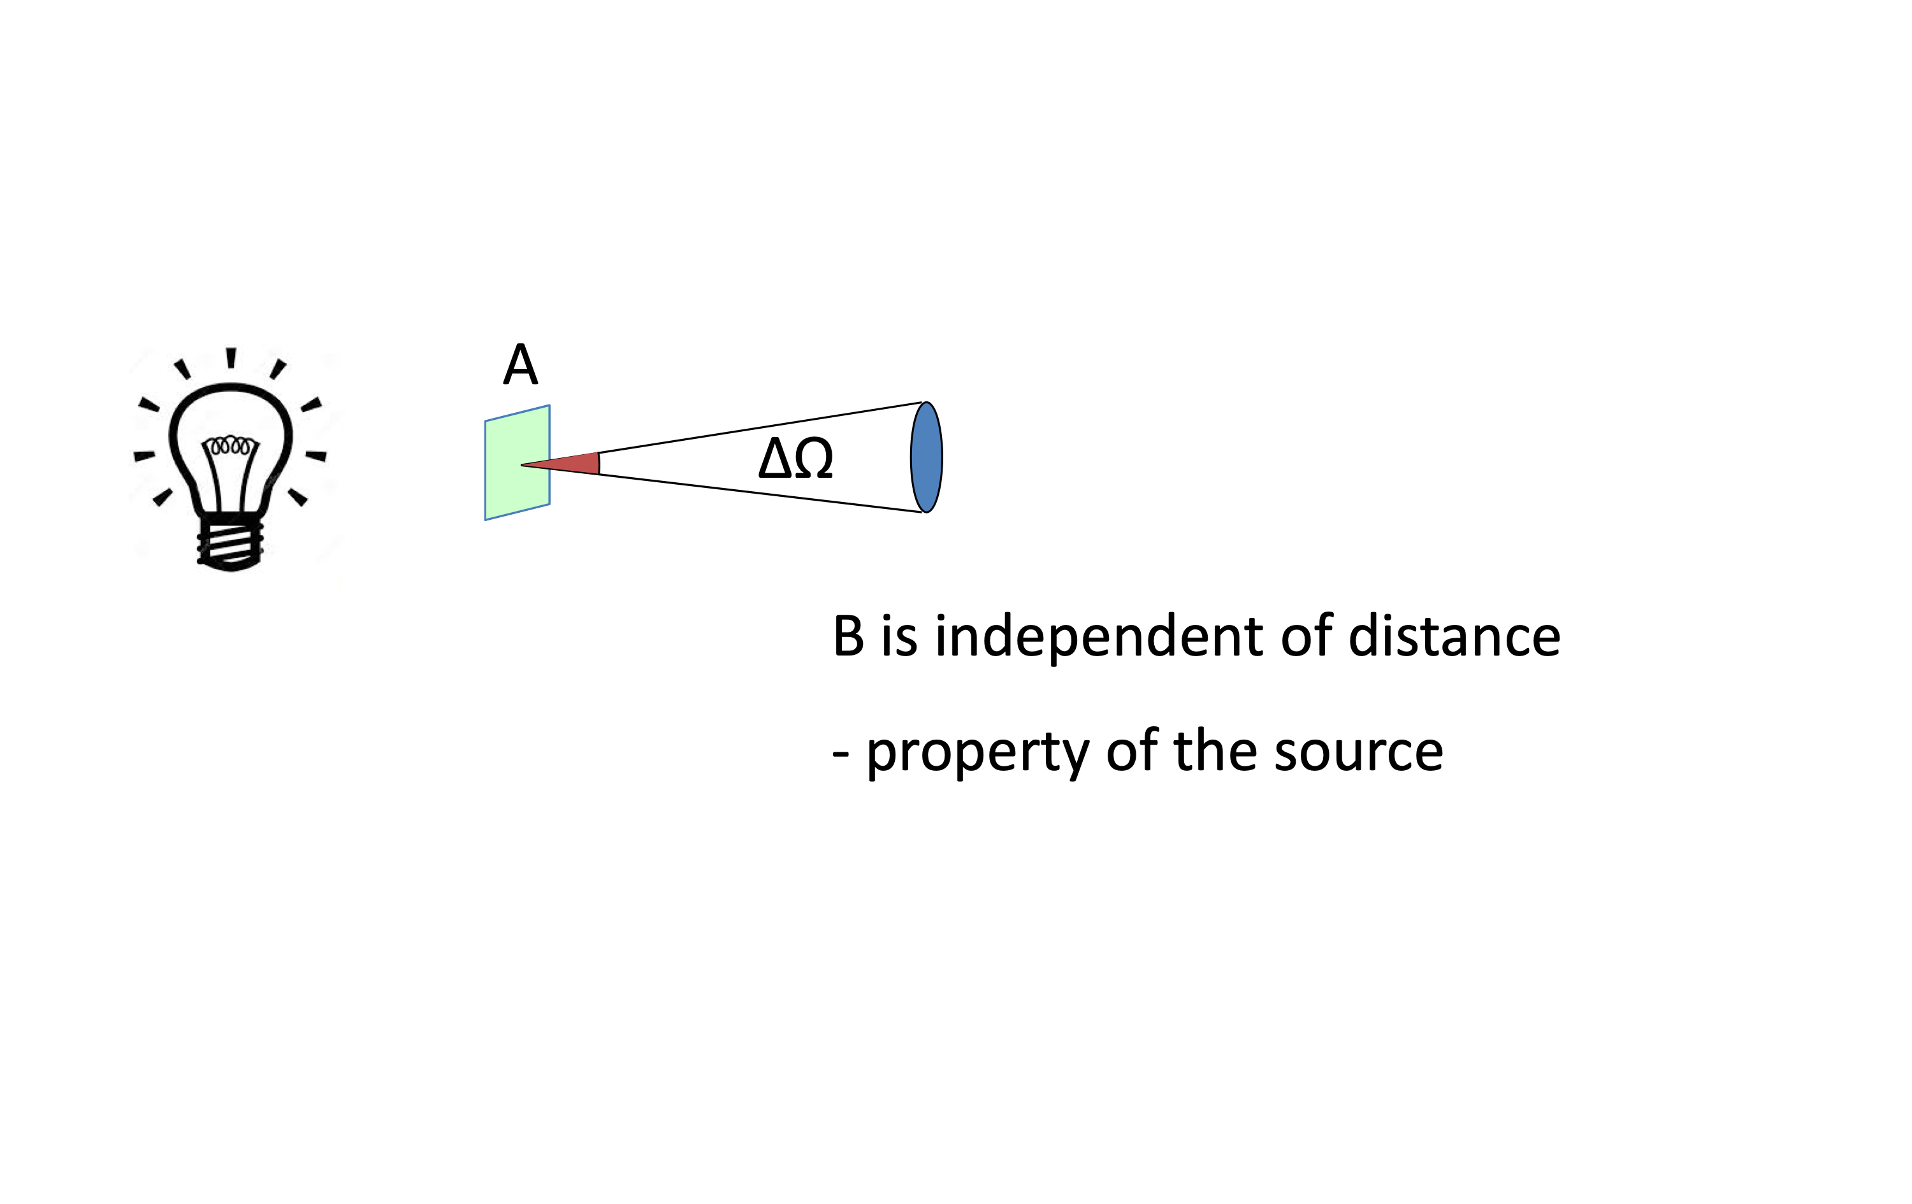
Neutron flux - and brilliance / brightness

Slide 9
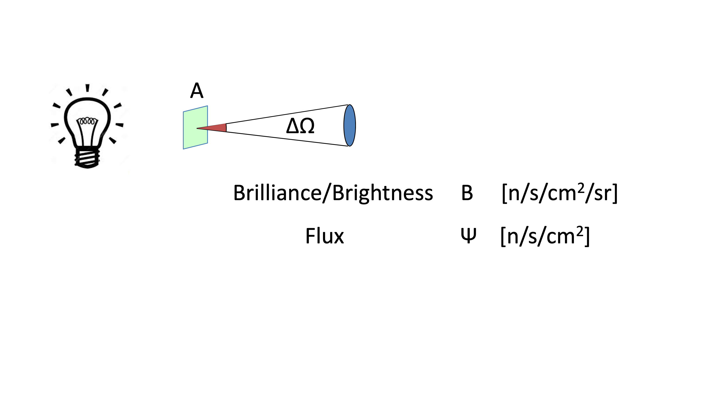
Neutron flux - and brilliance / brightness

Slide 10
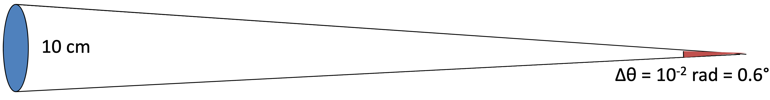

Neutron flux - and brilliance / brightness
10 m

Slide 11
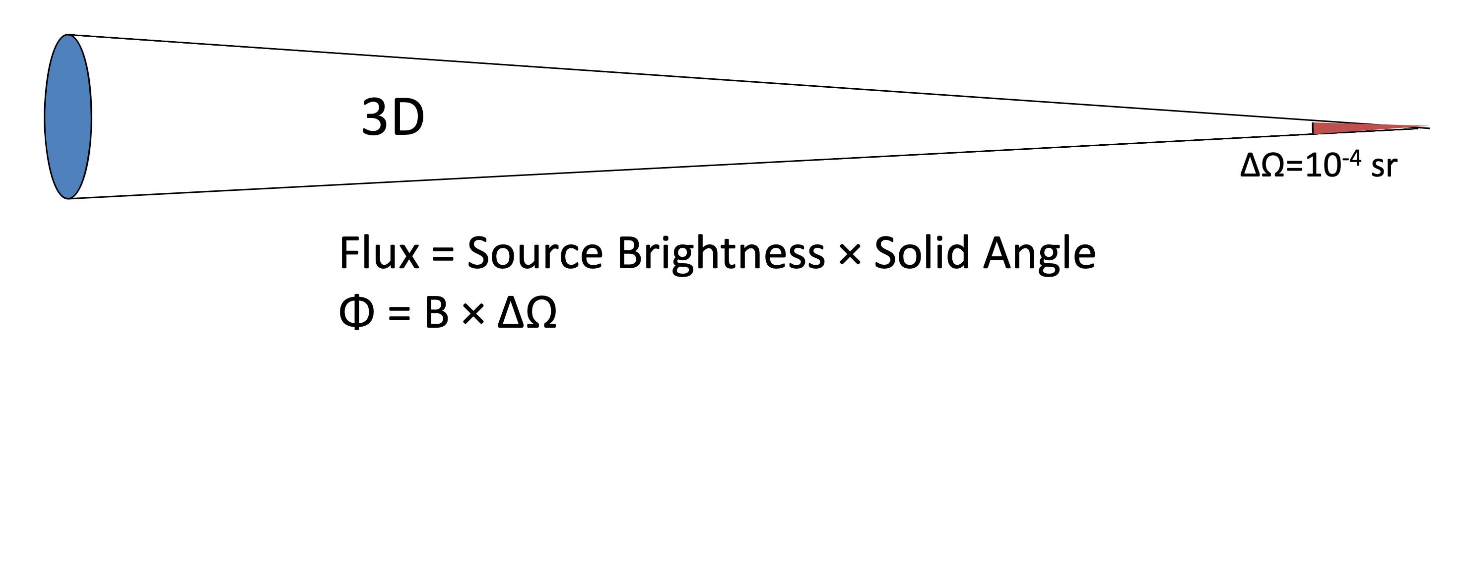
Neutron flux - and brilliance / brightness
10 m

Slide 12
Neutron flux - and brilliance / brightness
10 m

Slide 13
Neutron flux - and brilliance / brightness
10 m

Slide 14
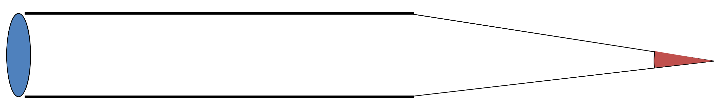
Neutron flux - and brilliance / brightness
10 m
n/s/cm⁻²

Slide 15
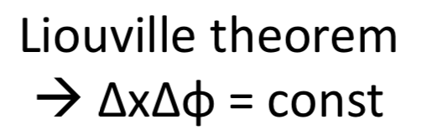
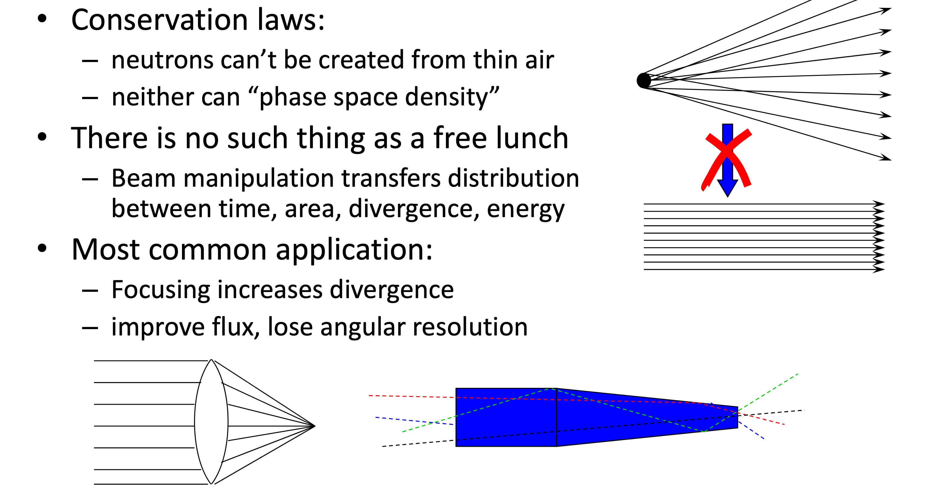
Liouvilles Theorem

Slide 16

Liouvilles Theorem
12

Slide 17
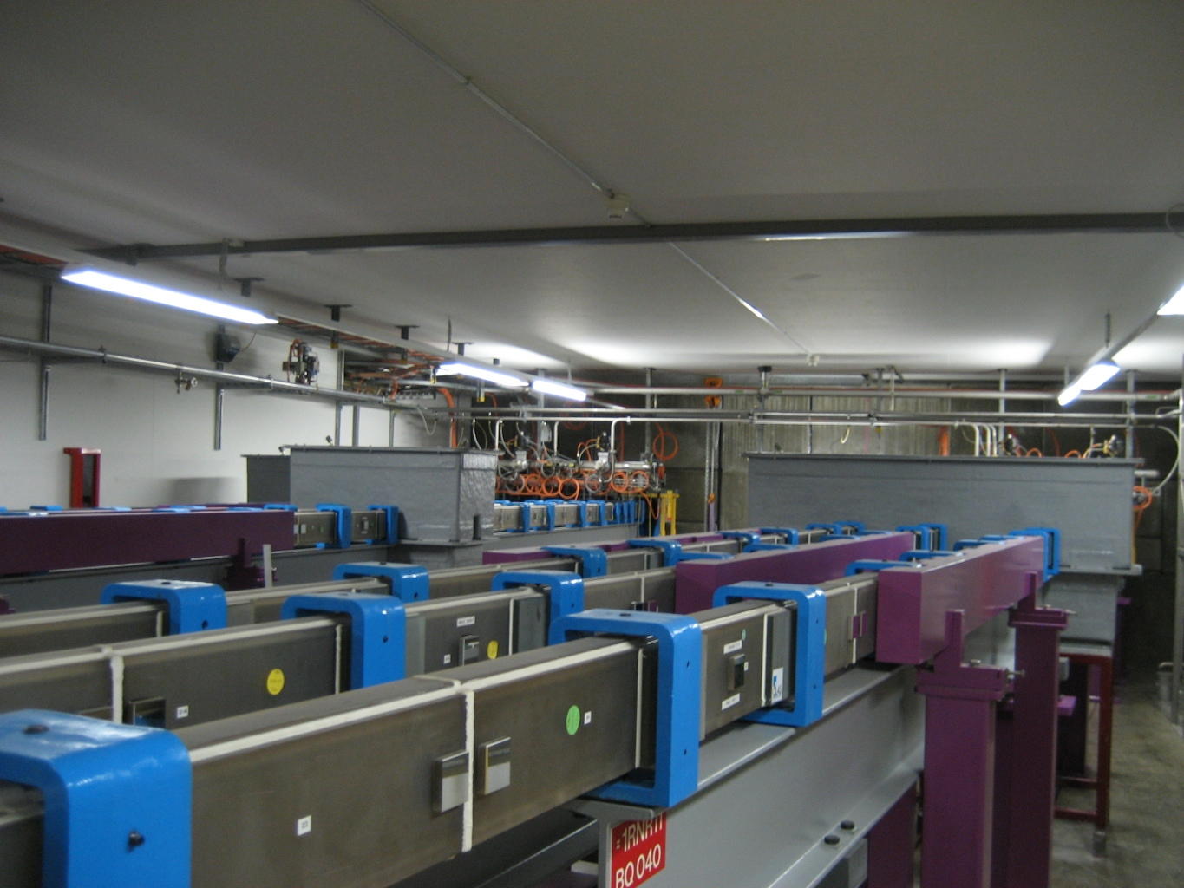
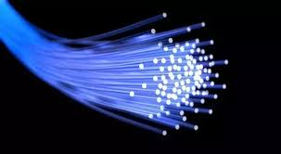
Neutron guides in bunker @ PSI
Text
Text
- think optical fiber, however not total internal, rather total external reflection

Slide 18
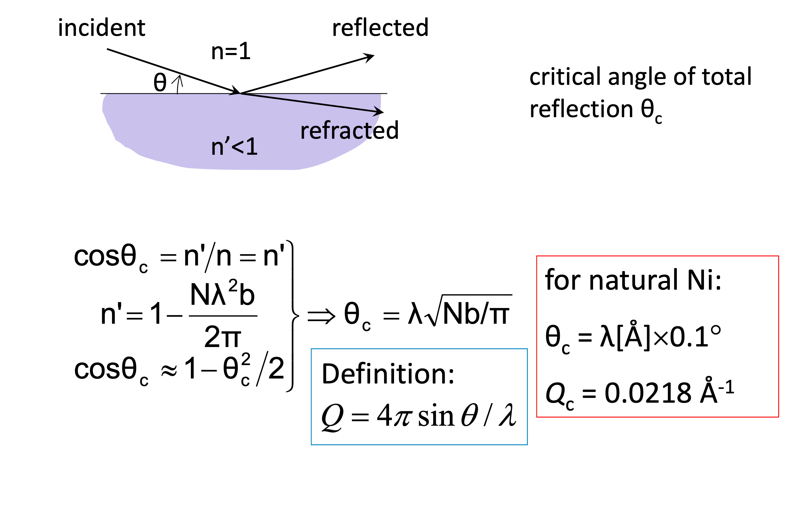
Reflection: Snell’s Law

Slide 19
Reflection: Snell’s Law

Slide 20
Reflection: Snell’s Law
H. Maier-Leibnitz and T. Springer Reactor Science and Technology 1963. Vol. 17. pp. 217 to 225

Slide 21
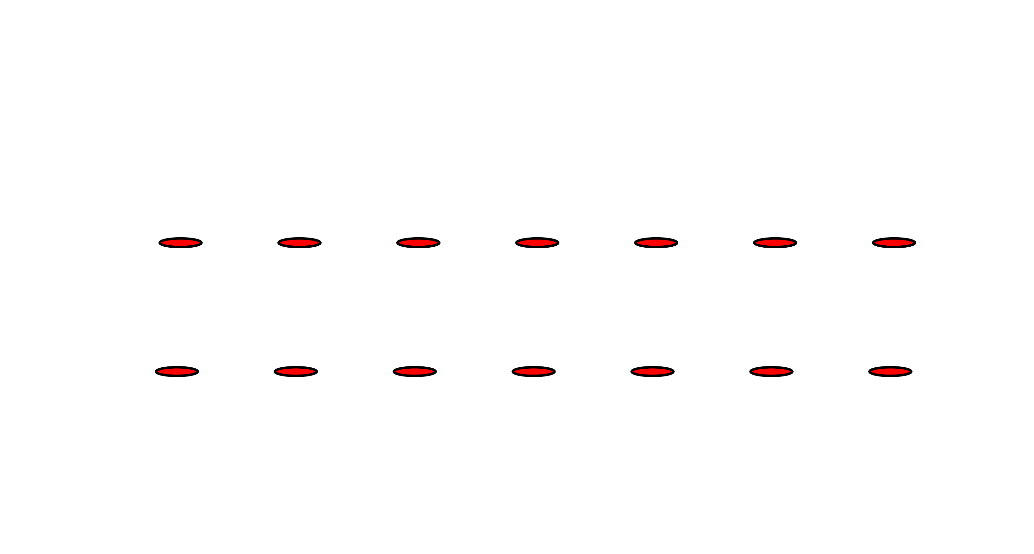
Diffraction: Bragg’s Law
Idea:
“Expand reflectivity by means of Bragg scattering?

Slide 22
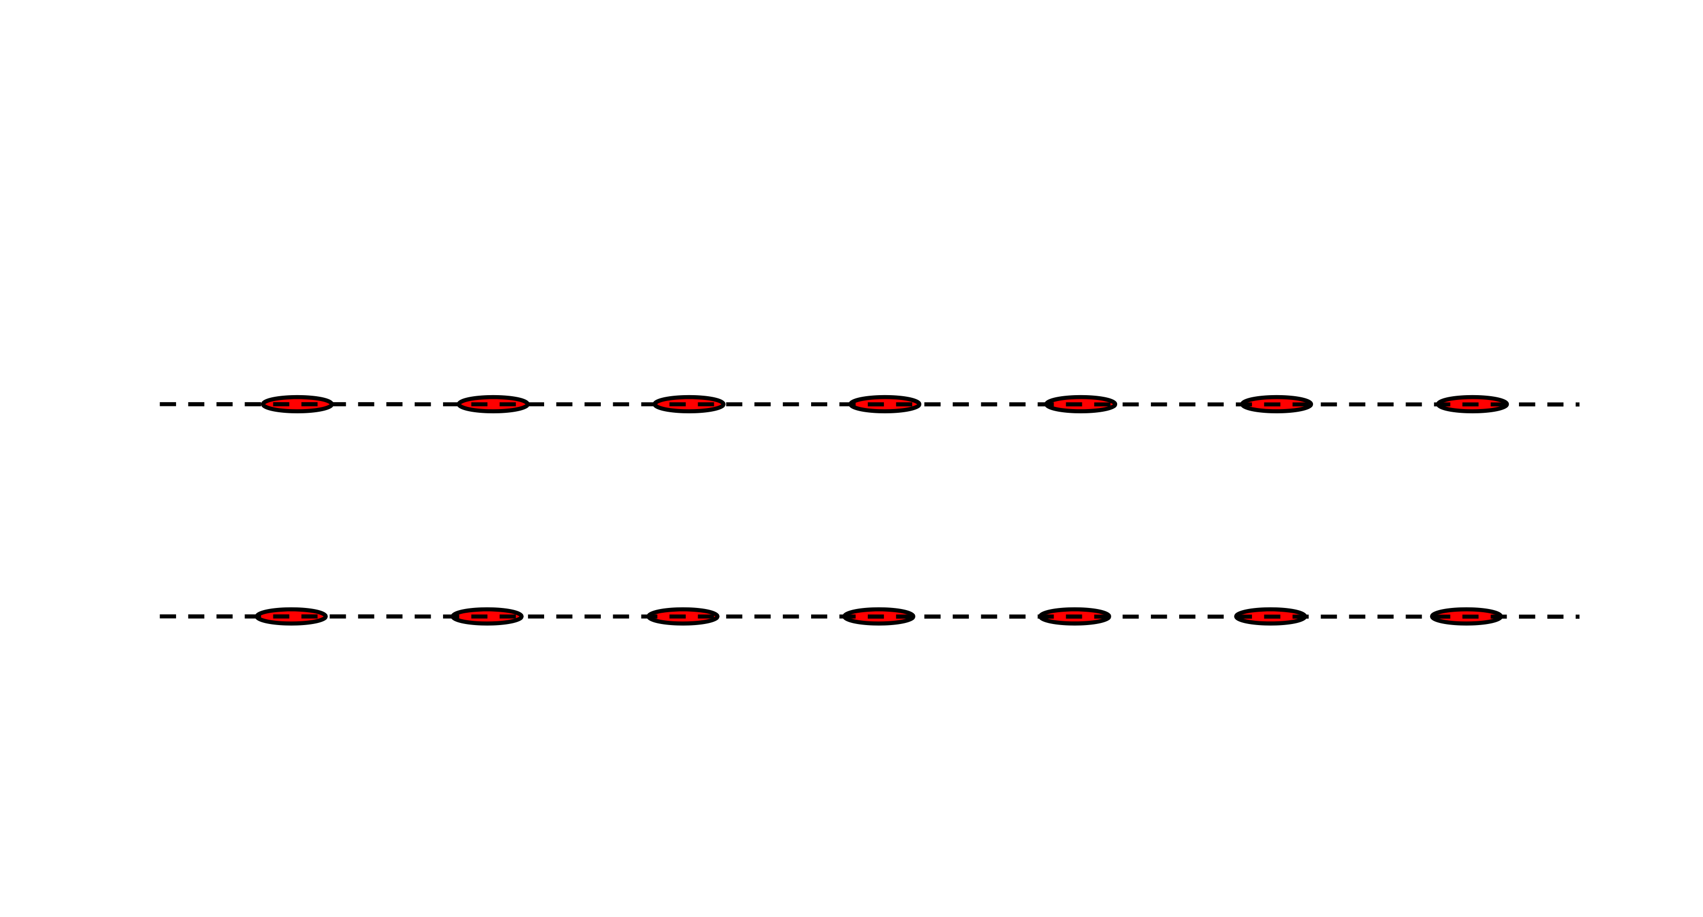
Diffraction: Bragg’s Law
Idea:
“Expand reflectivity by means of Bragg scattering?

Slide 23
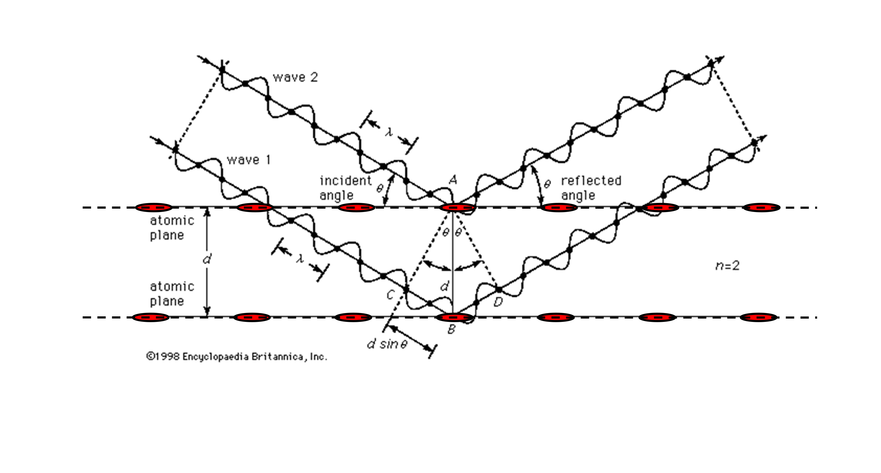
Diffraction: Bragg’s Law
Idea:
“Expand reflectivity by means of Bragg scattering?

Slide 24
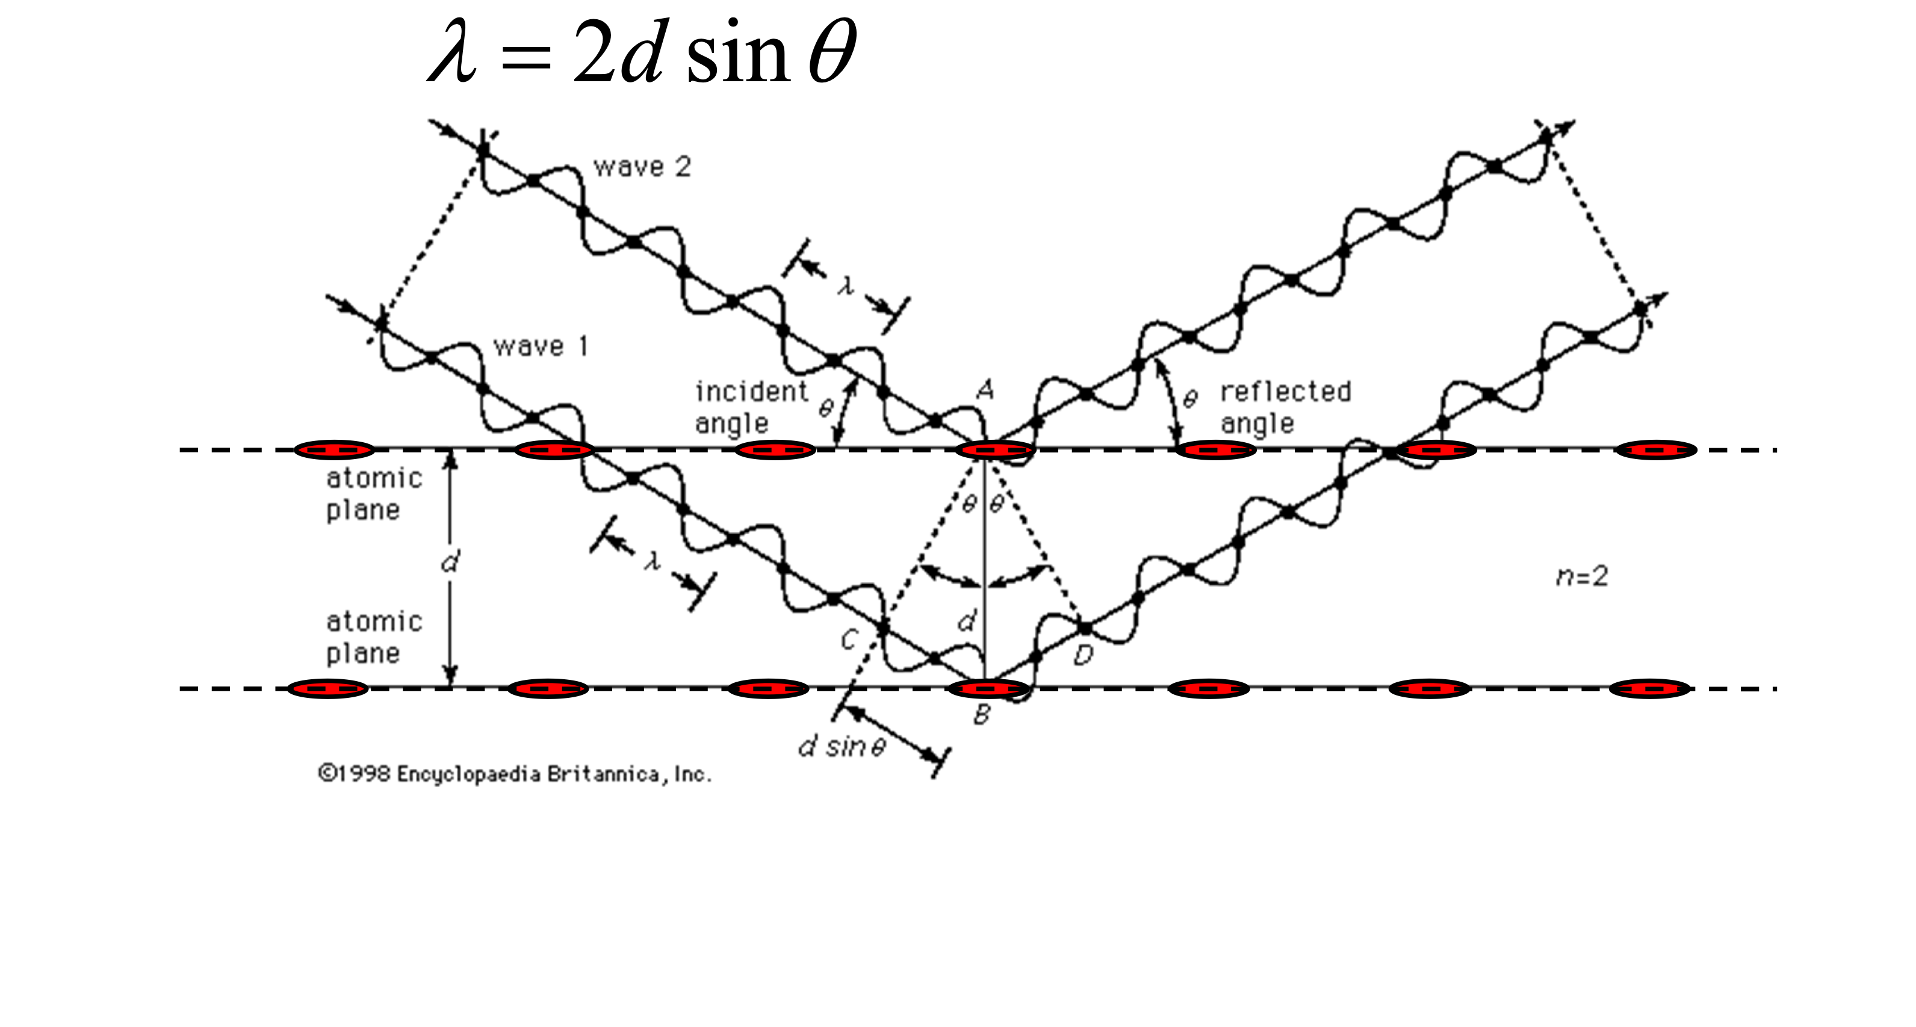
Diffraction: Bragg’s Law
Idea:
“Expand reflectivity by means of Bragg scattering?

Slide 25
Diffraction: Bragg’s Law
Idea:
“Expand reflectivity by means of Bragg scattering?
2𝝧

Slide 26
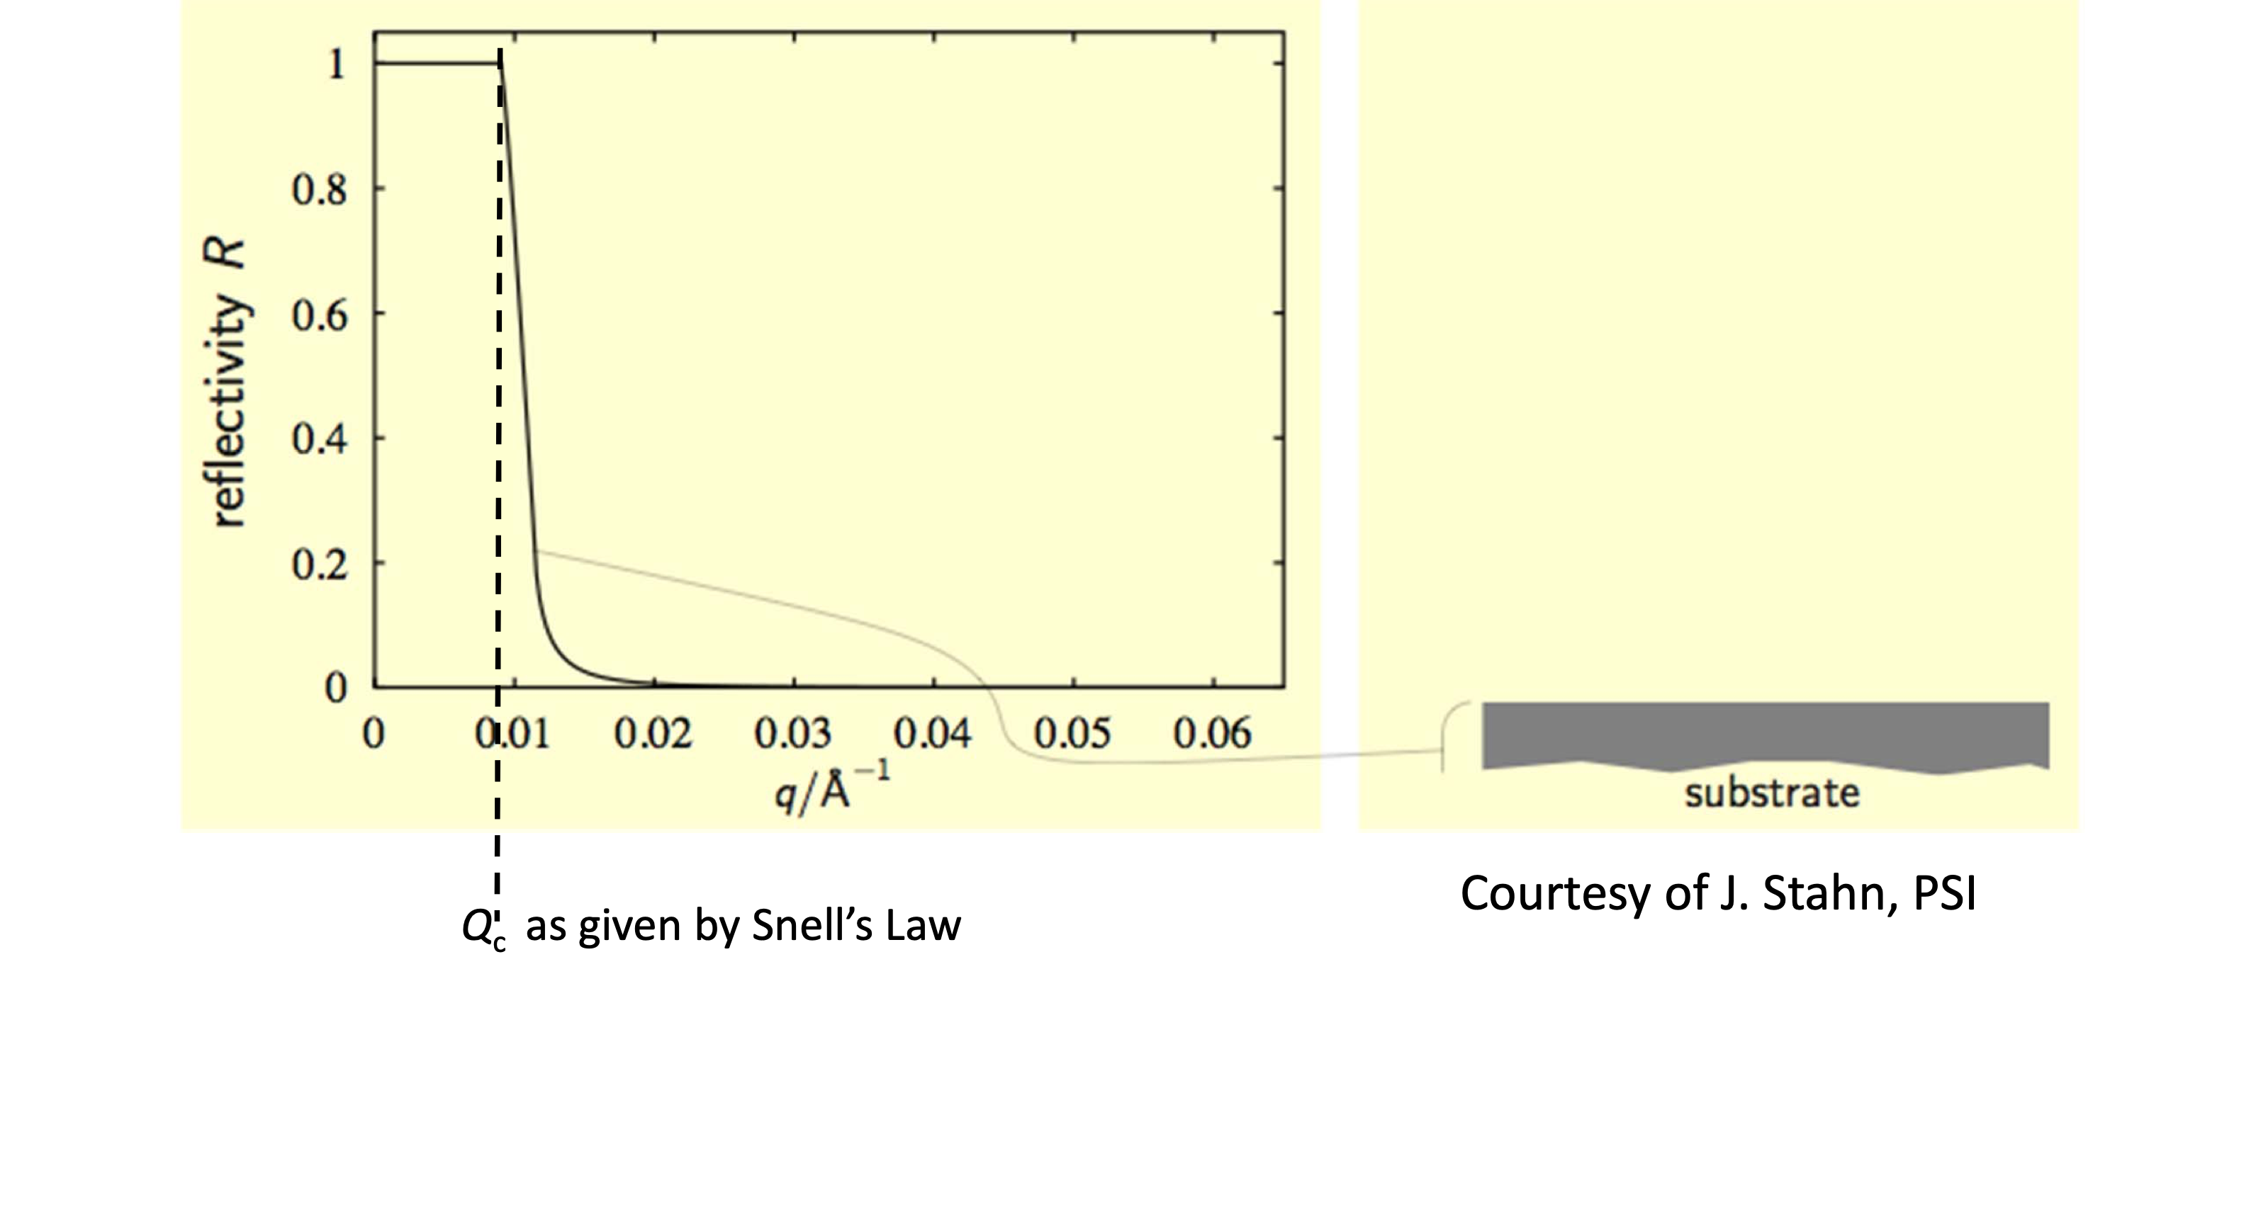
Neutron Supermirrors

Slide 27
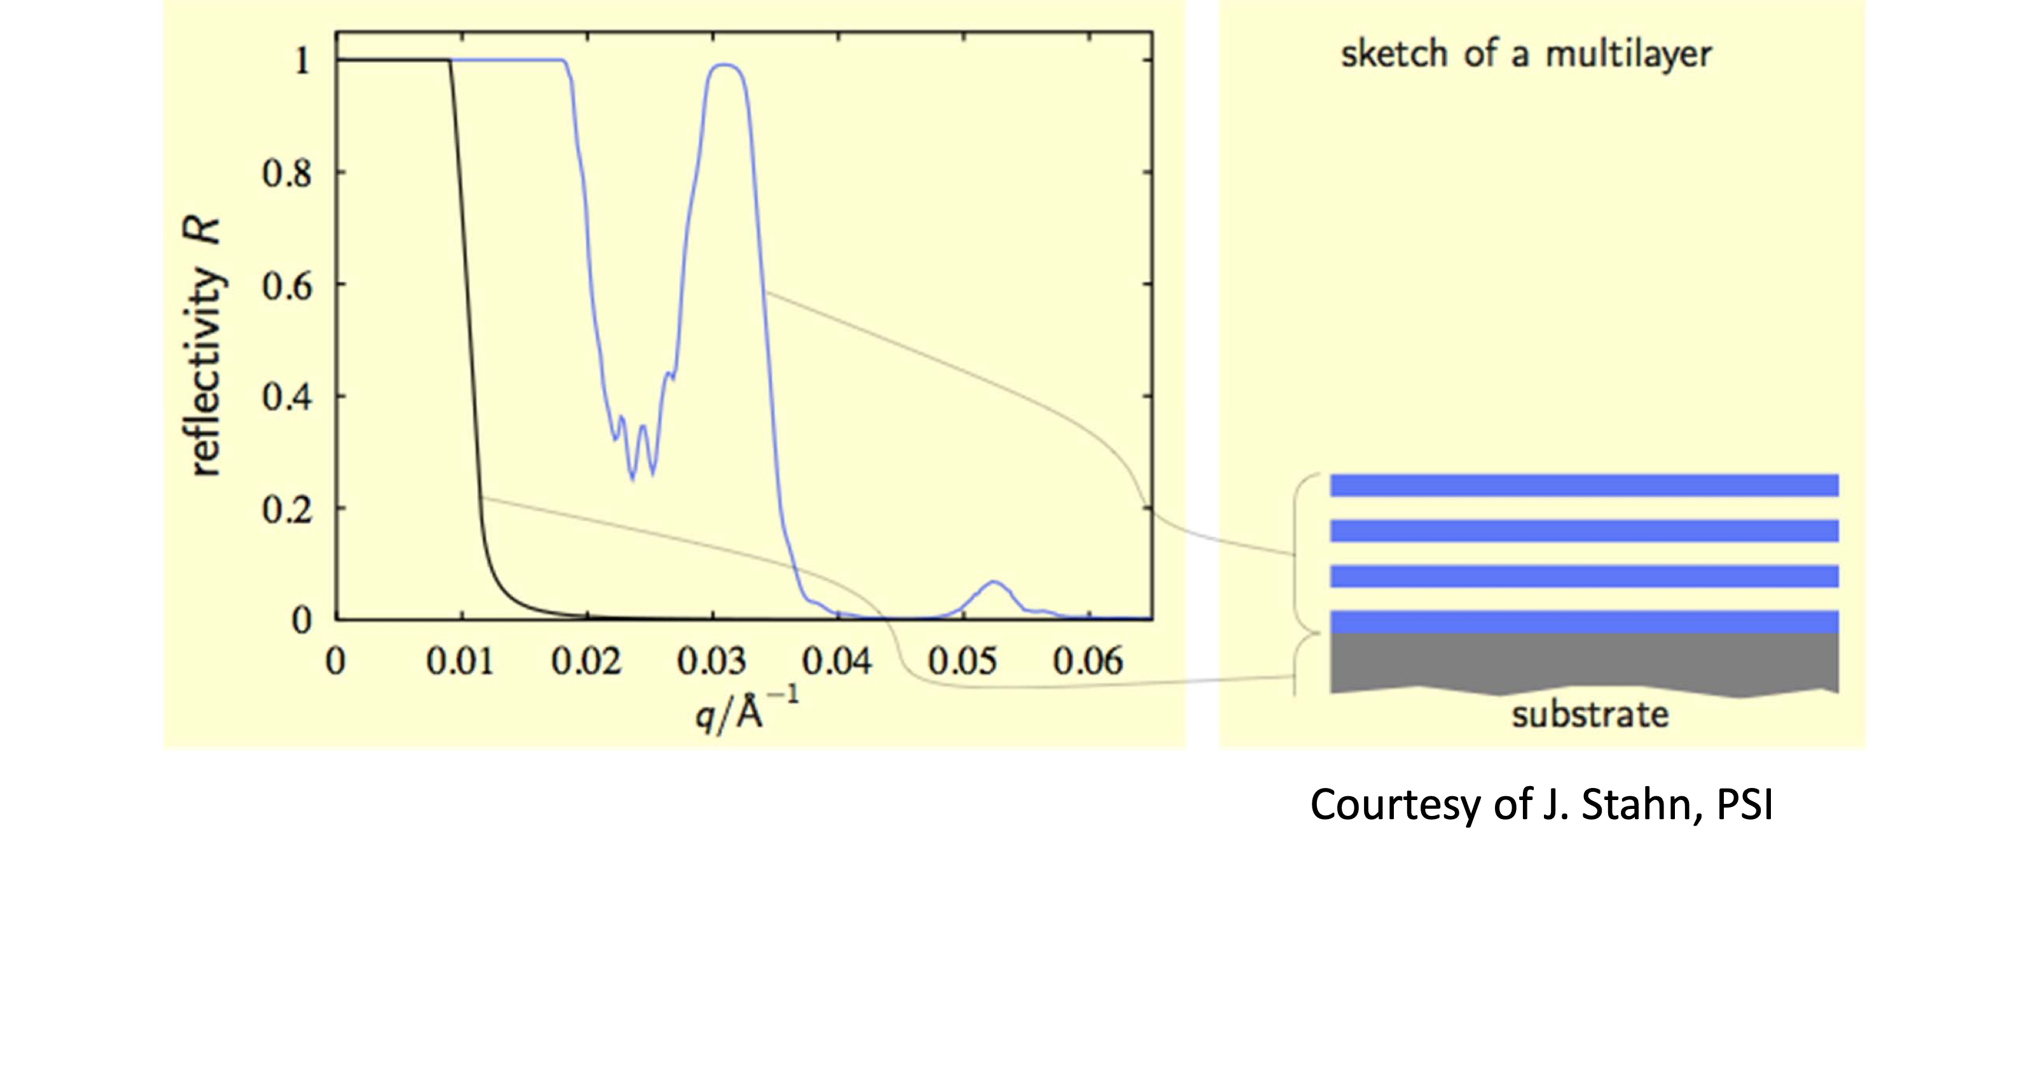
Neutron Supermirrors

Slide 28
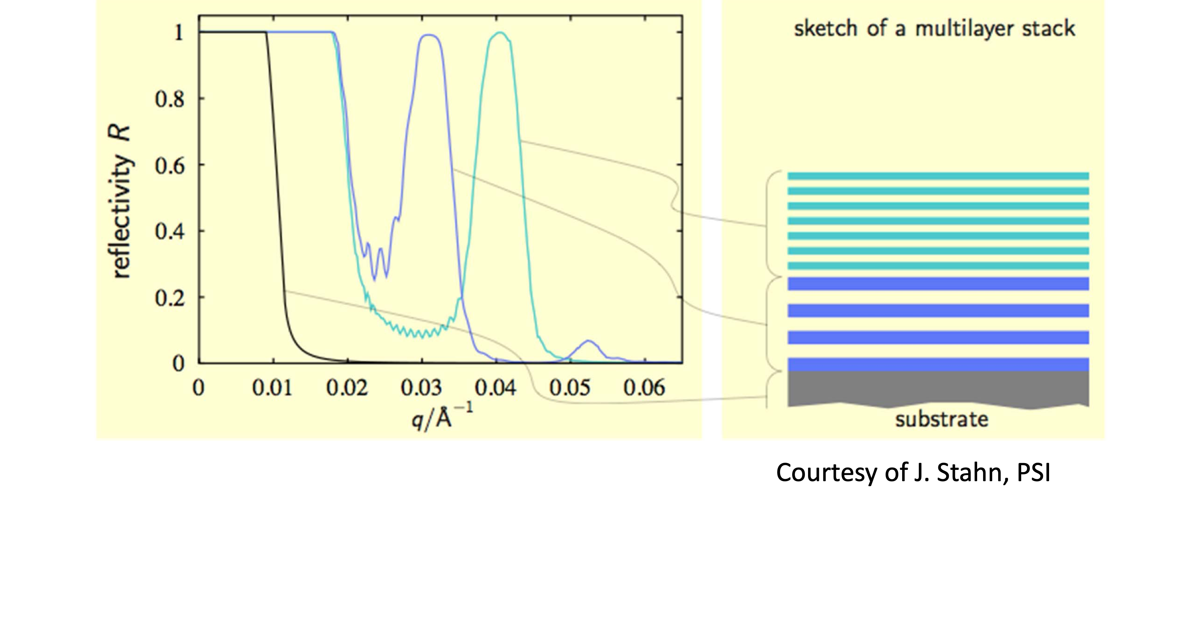
Neutron Supermirrors

Slide 29
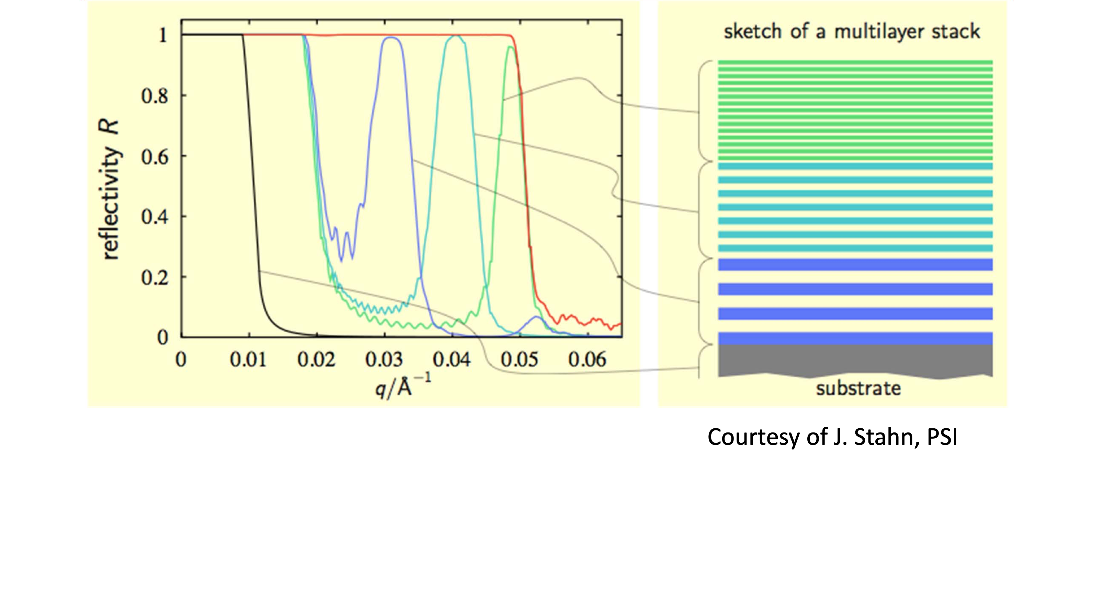
Neutron Supermirrors

Slide 30
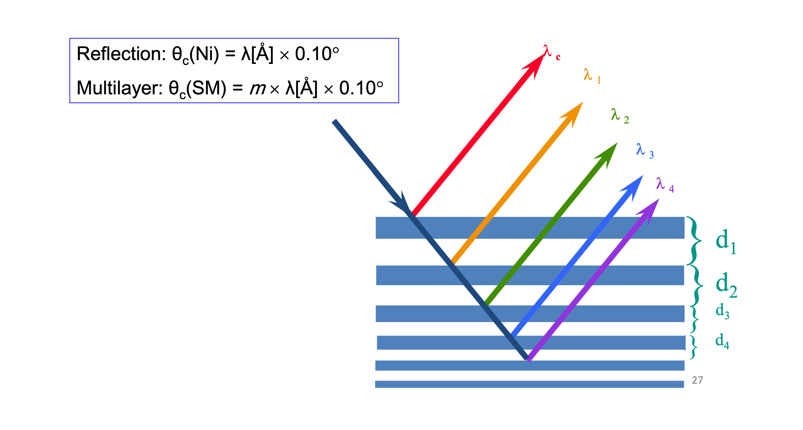
Neutron Supermirrors

Slide 31
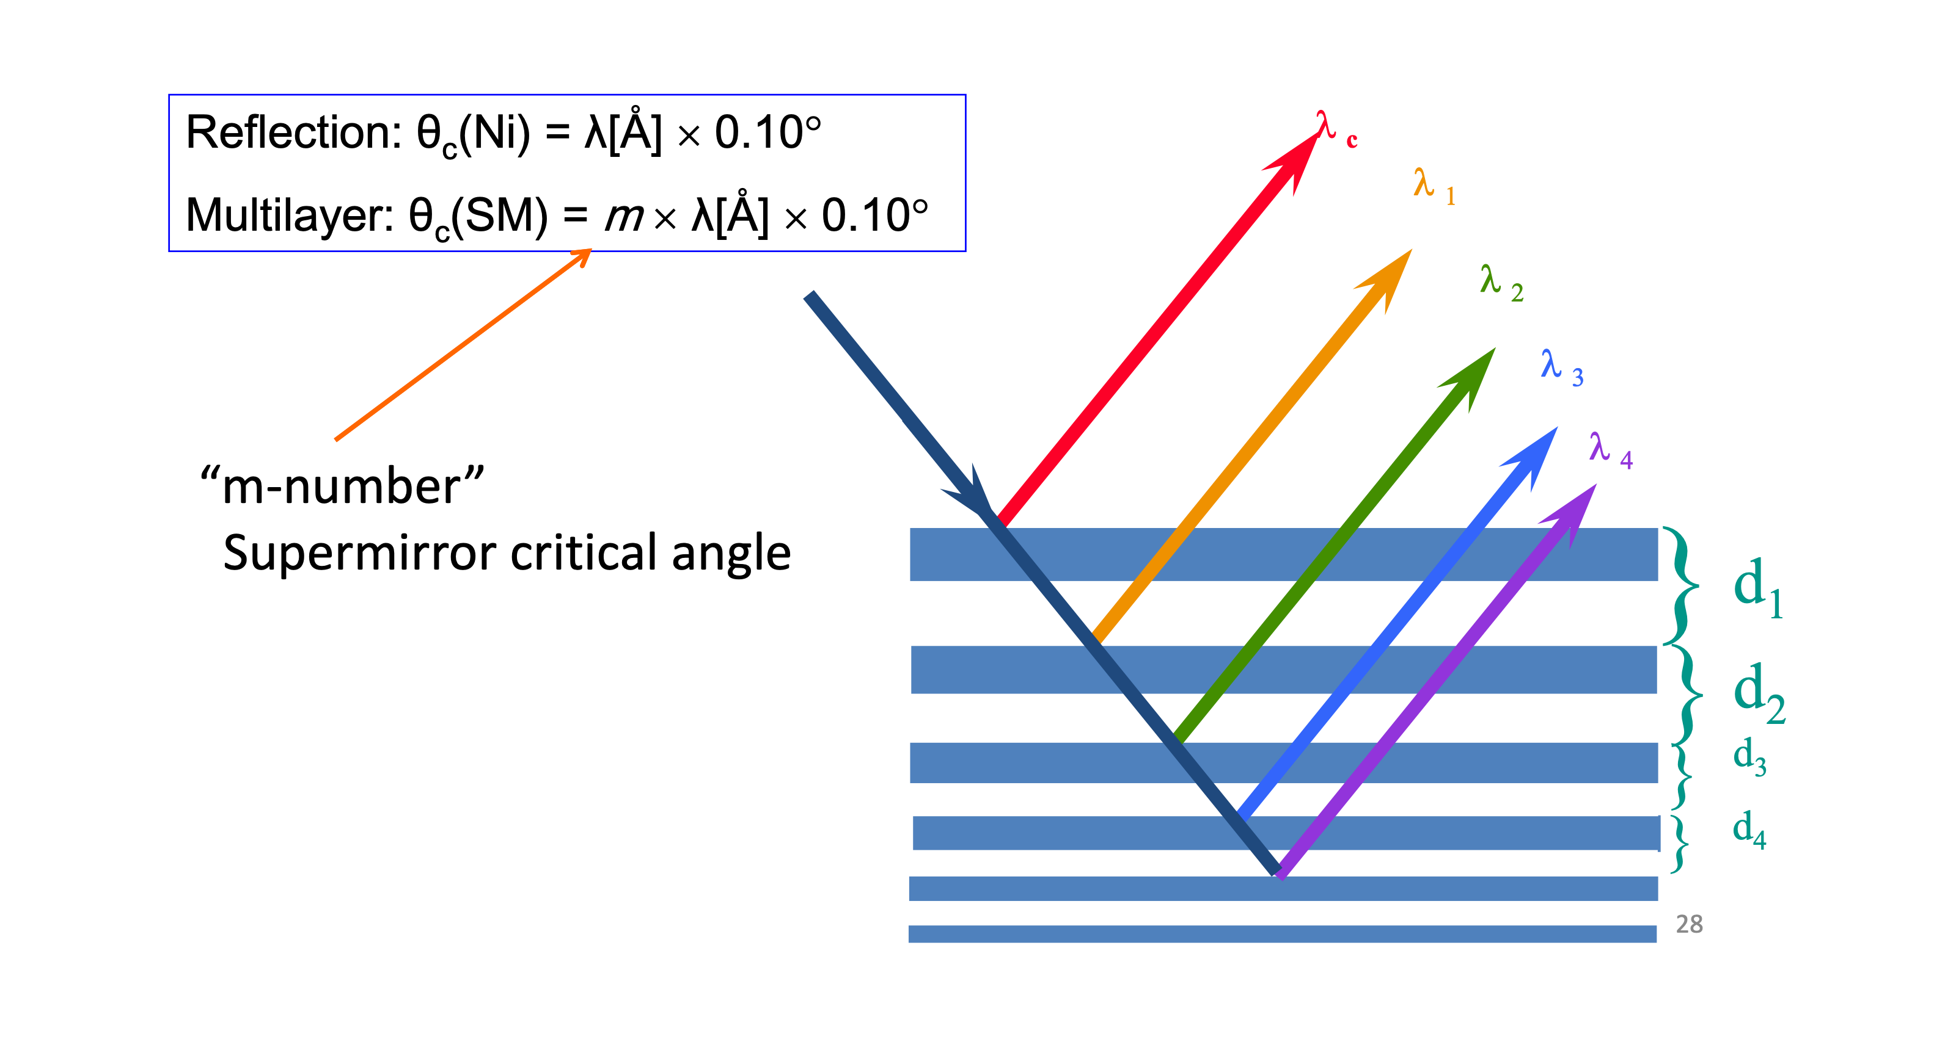
Neutron Supermirrors
Mezei, F.; Communications on Physics 1976, Volume 1, Issue 3, pp. 81-85
Mezei, F.; Dagleish, P. A. Communications on Physics 1977, Volume 2, Issue 2, pp. 41-3

Slide 32
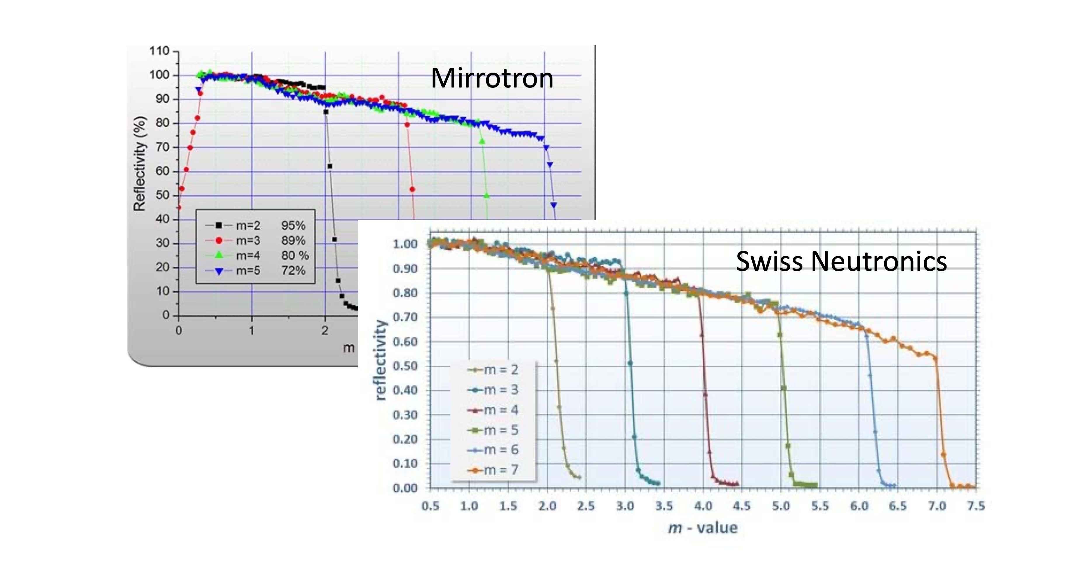
State-of-the-art Supermirrors (2015?)

Slide 33
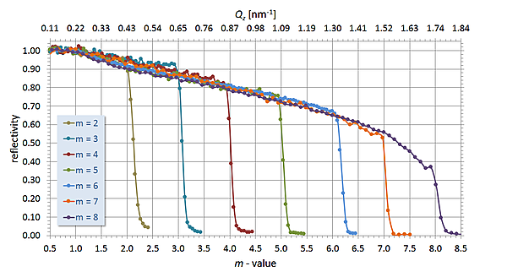
State-of-the-art Supermirrors (2019)
Swiss Neutronics

Slide 34
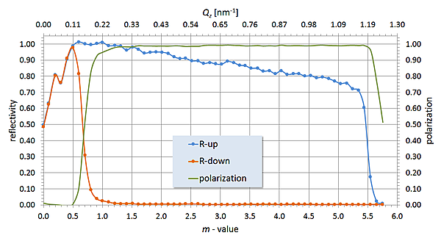
State-of-the-art Polarising Supermirrors (2019)
Swiss Neutronics

Slide 35
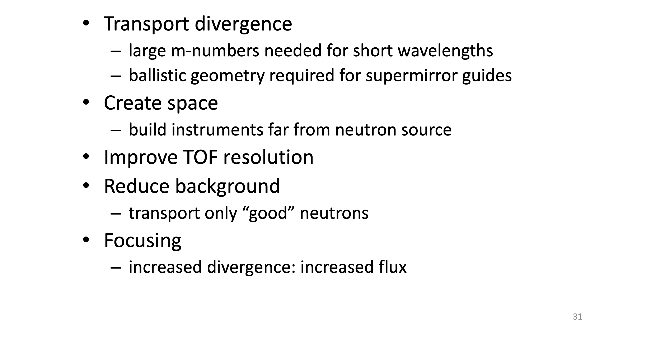
What are guides used for?

Slide 36
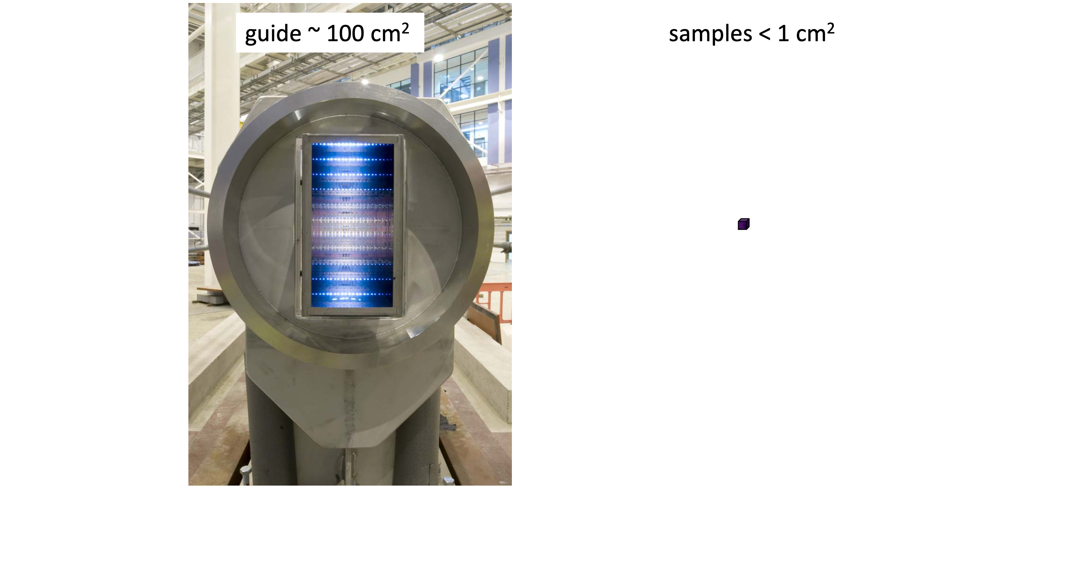
Focusing

Slide 37
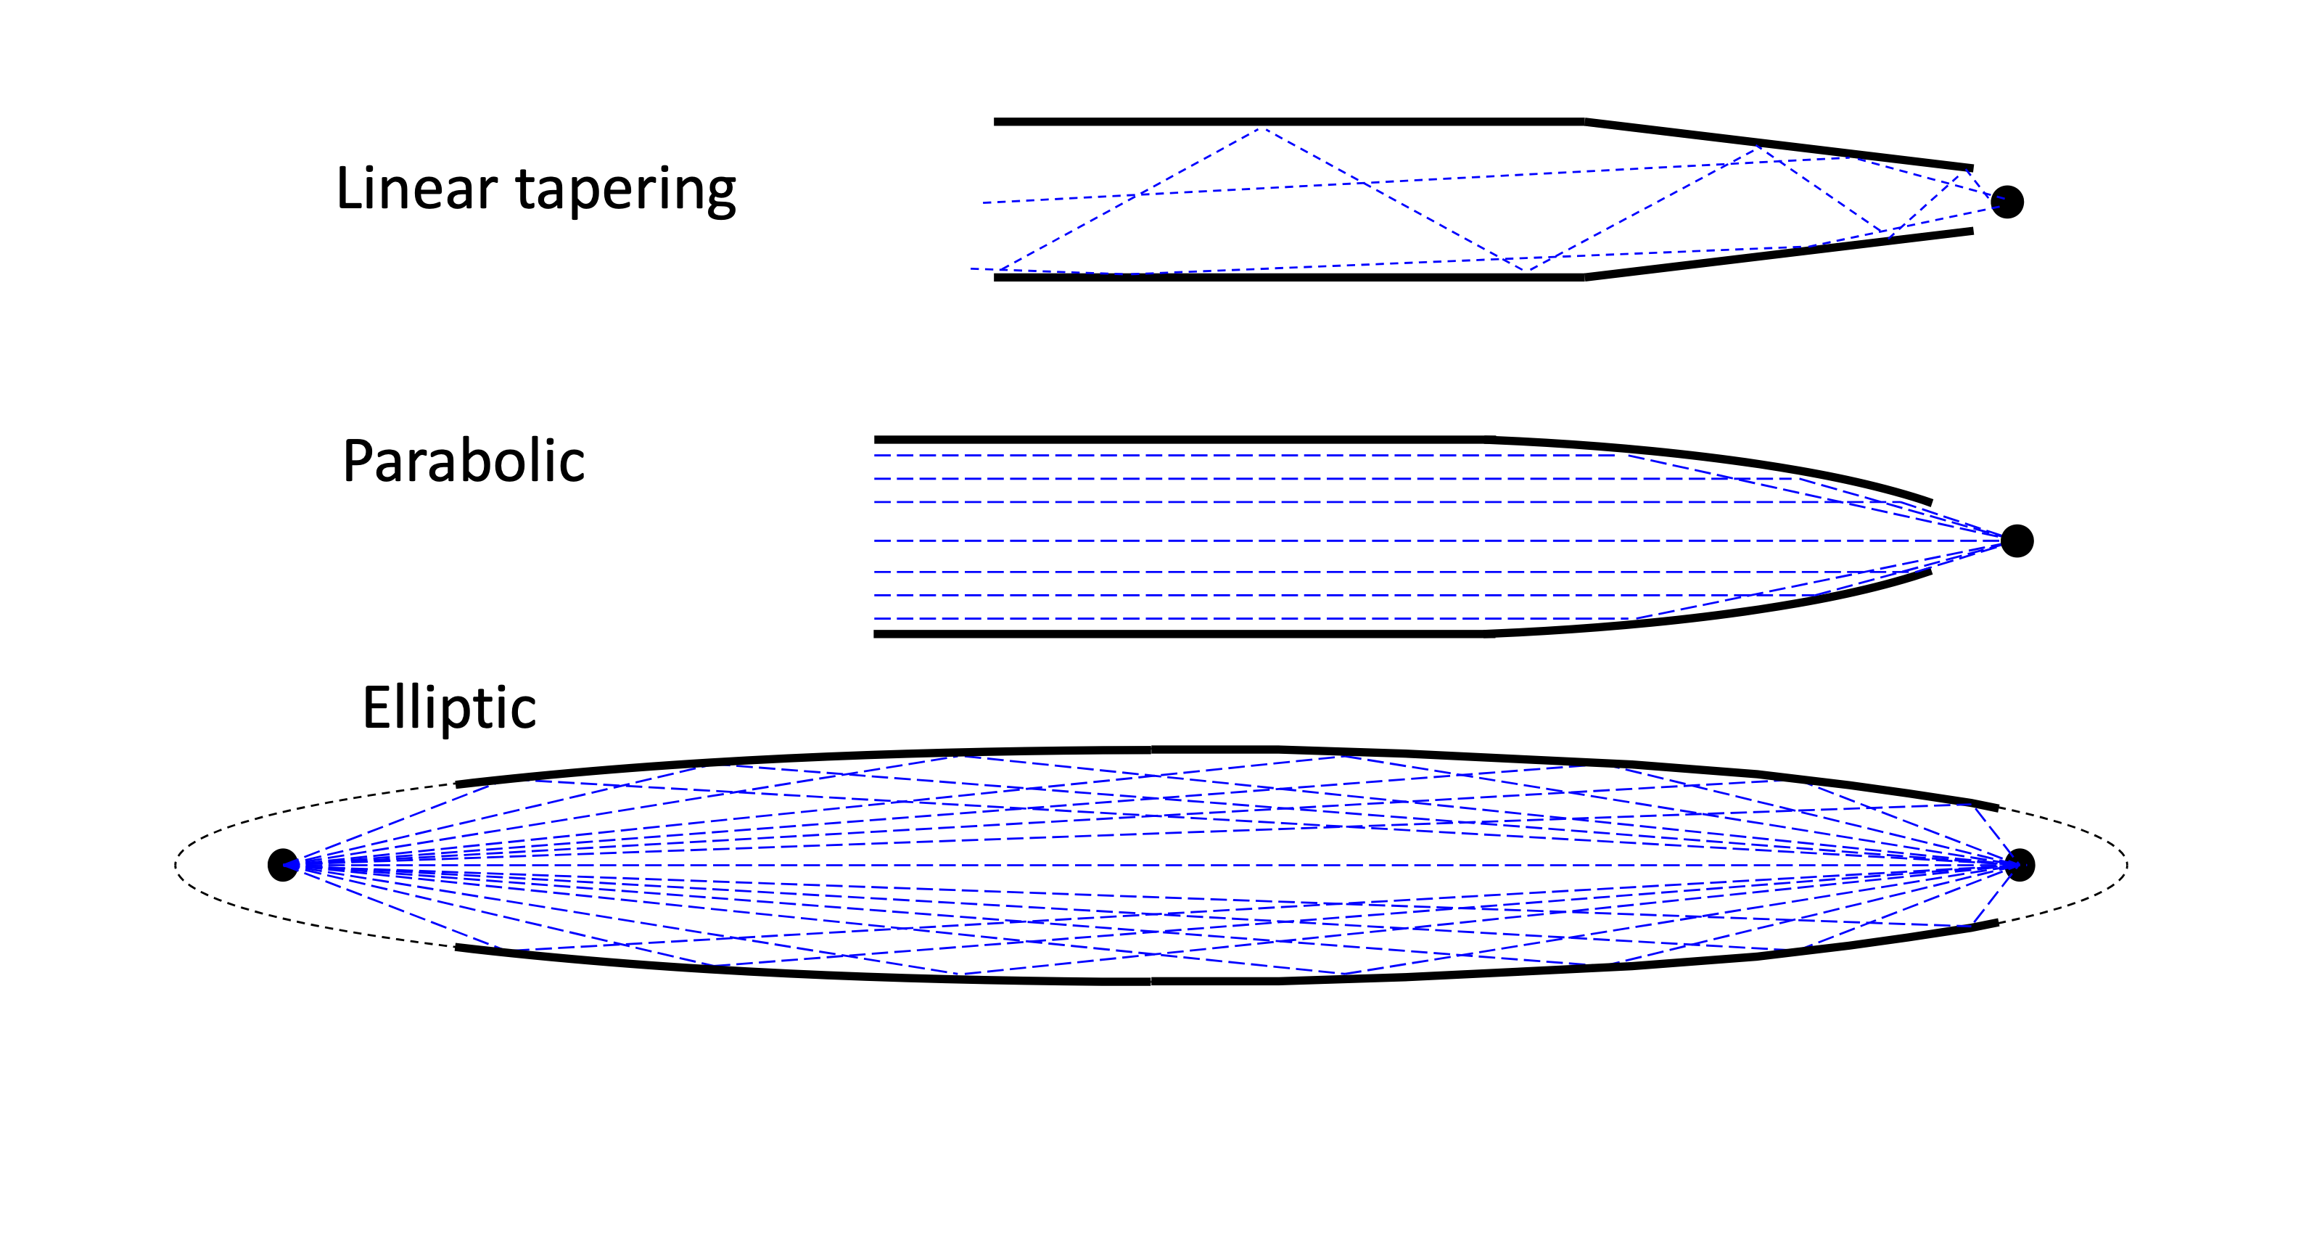
Focusing

Slide 38
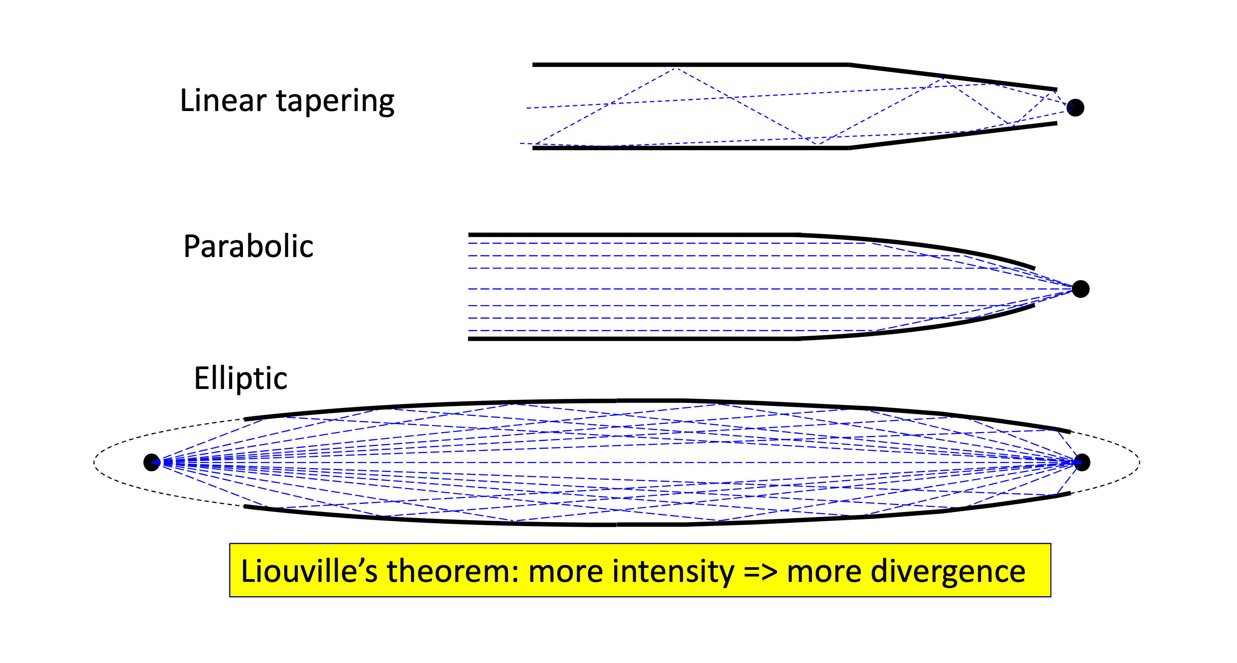
Focusing

Slide 39
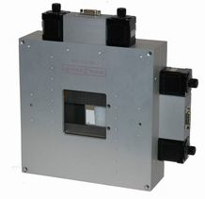
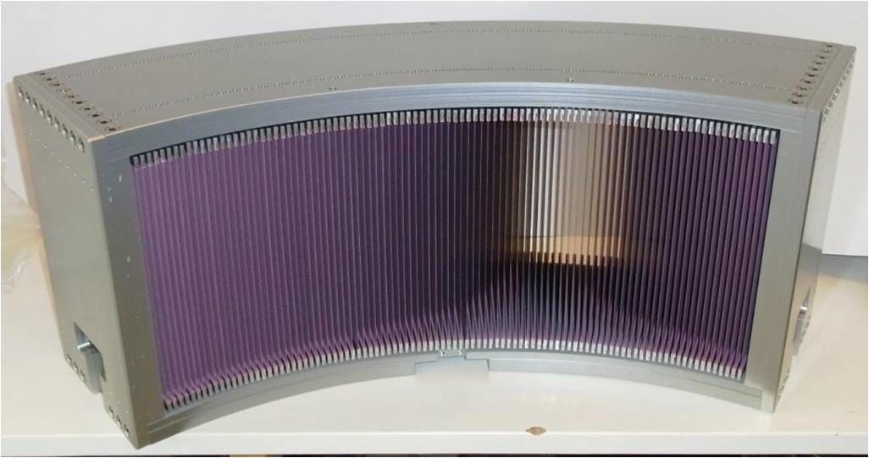
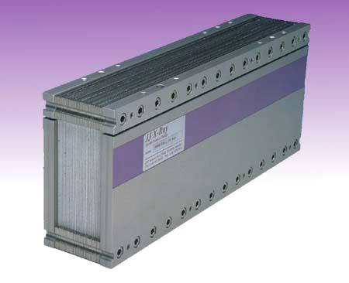
Spatial, directional beam tailoring
Slit: (configurable) opening in absorbing material
Collimators: Limiting divergence by sheets of absorbing material

Slide 40
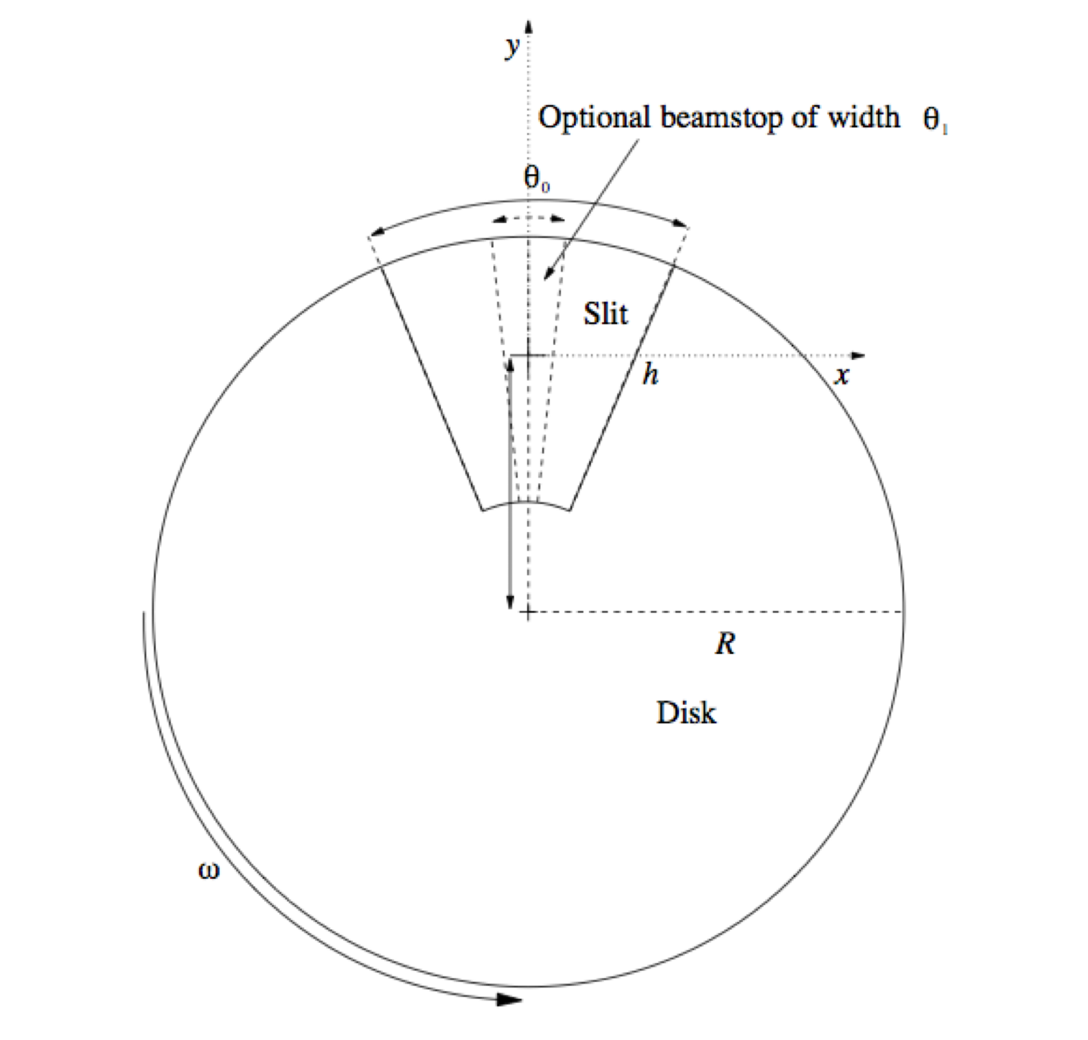
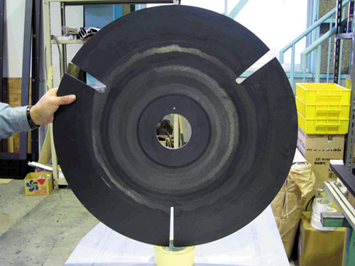
Disk Chopper - a “rotating slit”
s
c
Spatio-temporal tailoring of the beam
A cascade of these will introduce spectral filtering

Slide 41
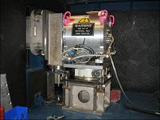
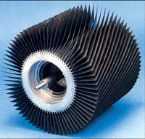
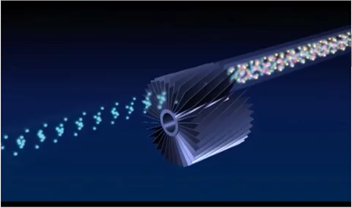

Velocity selector
ILL - SANS instrument D11: a "microscope" for exploring the nanoworld (YouTube)
A sort of “rotating collimator”
Spectral tailoring of the beam

Slide 42
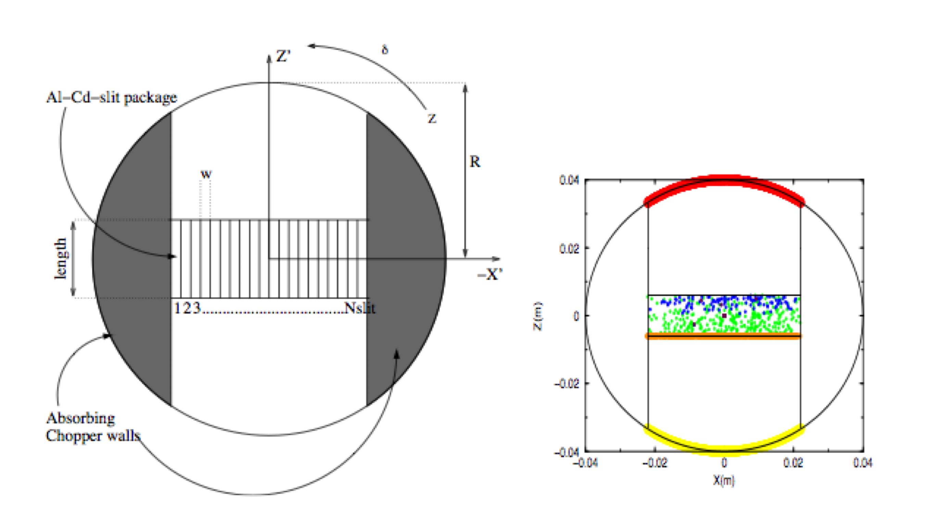
Fermi Choppers
slit-package (can be SM-coated)
$$\frac{δλ}{λ}≈1\%$$
Spectro-temporal tailoring of the beam, quite monochromatic

Slide 43
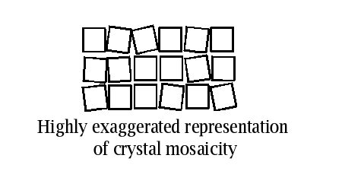
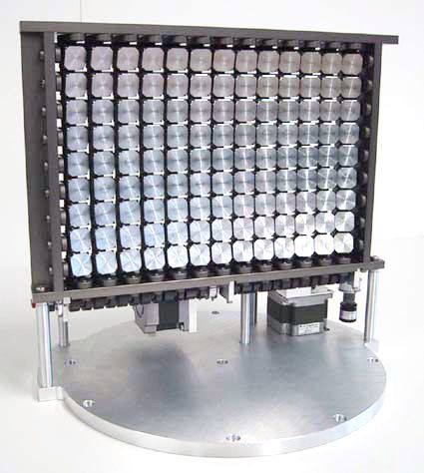
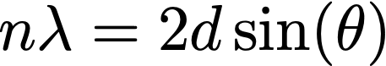
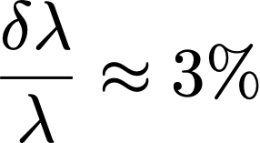
Crystal monochromators (and analyzers)
Often far from being perfect single crystals
Various means of increasing crystal mosaicity are used
impacts divergence
focusing geometries
PG
Spectral tailoring via Bragg’s law

Slide 44
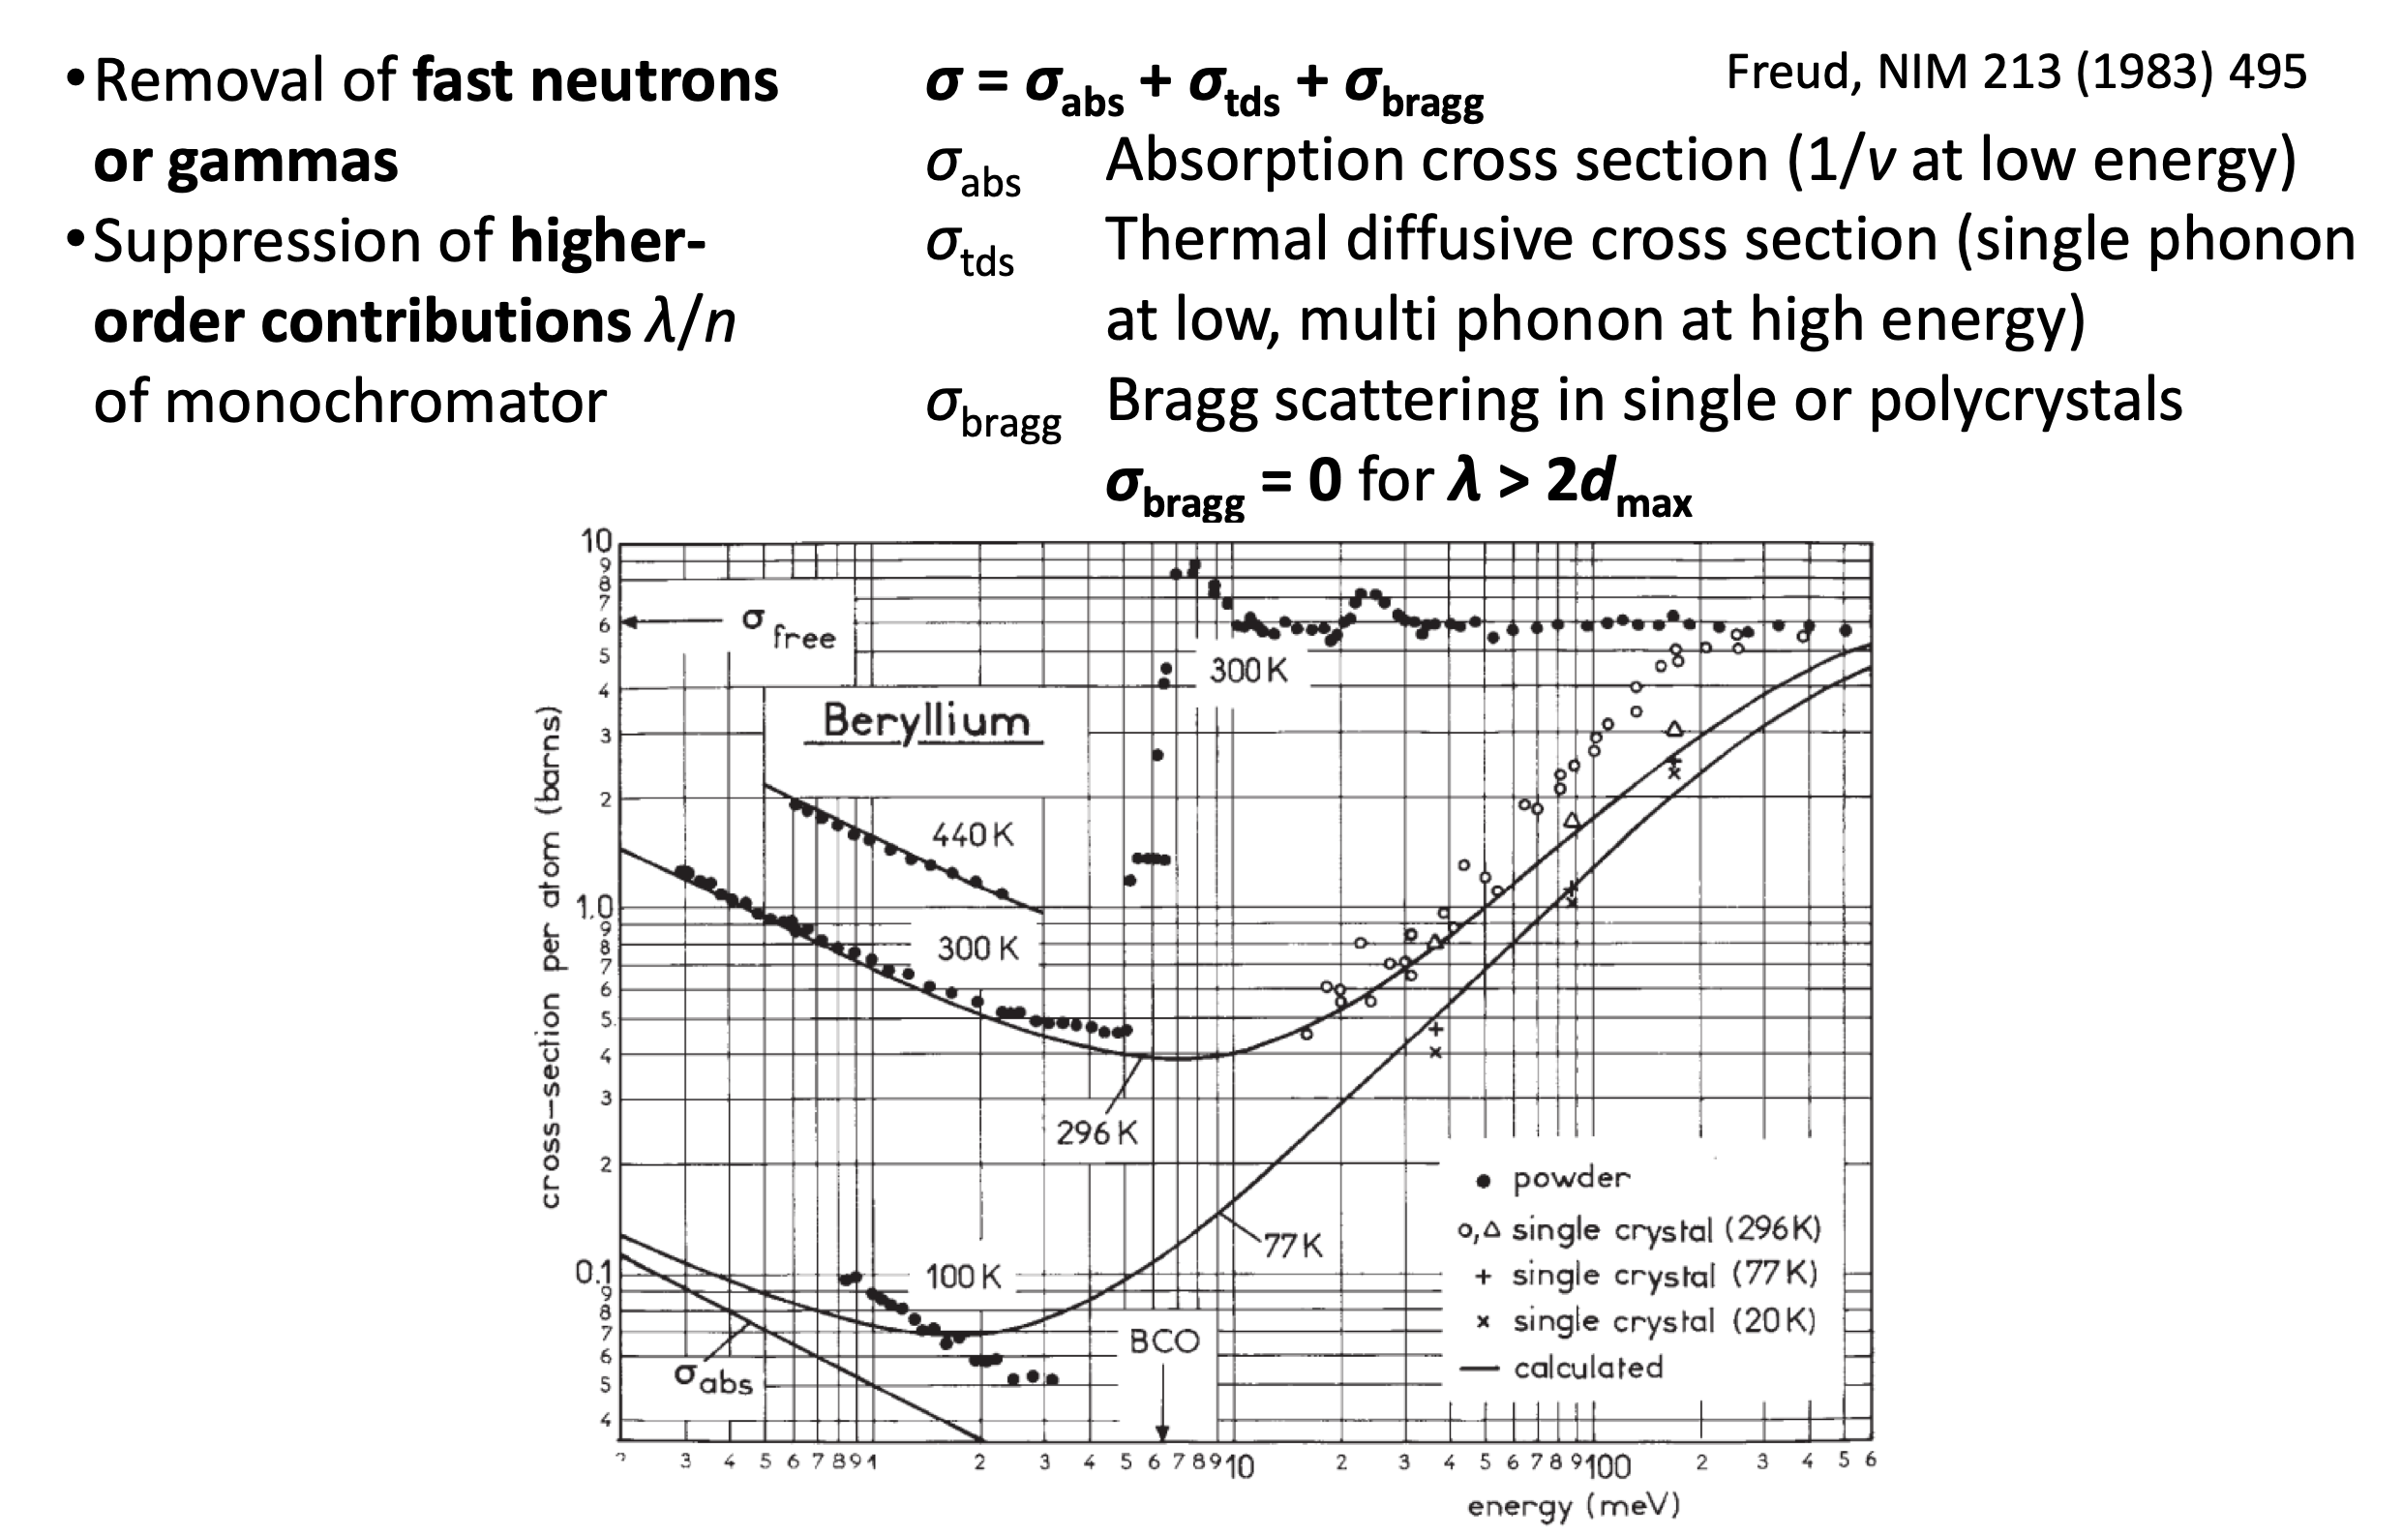
Filters…
Freund, NIM 213 495 (1983)

Slide 45
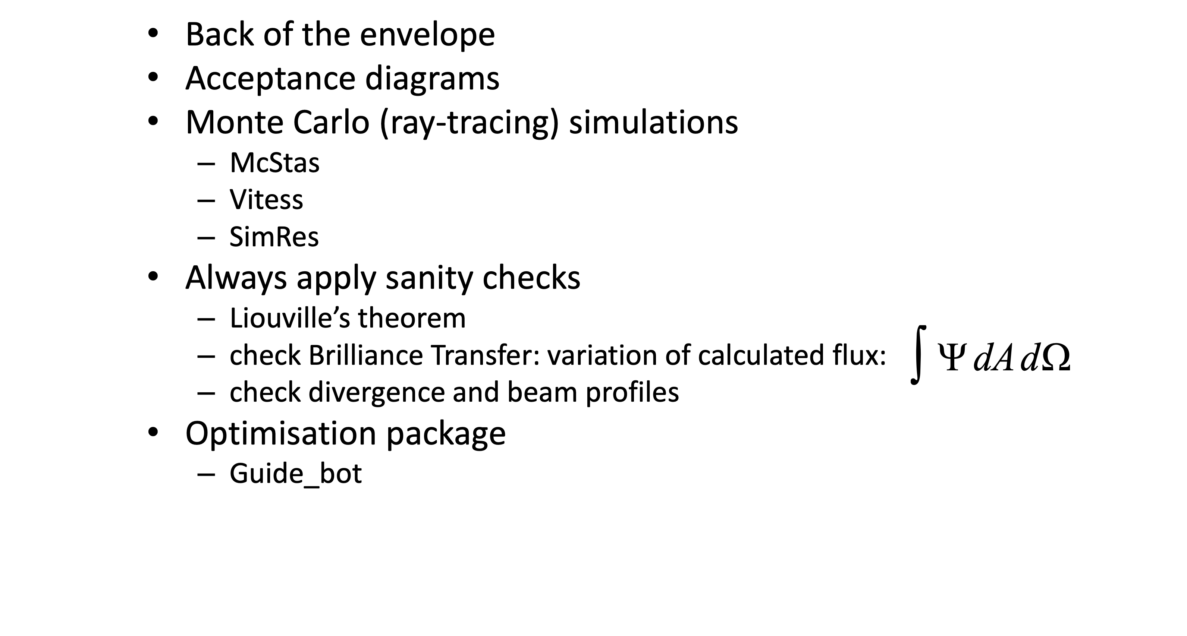
Techniques for neutron-optical design

Slide 46

Guide_bot McStas Optimisation
https://github.com/mads-bertelsen/guide_bot

Slide 47
Literature
G. L. Squires: Introduction to the Theory of Thermal Neutron Scattering, Cambridge Great all-round resource for understanding neutron-matter interaction
V. F. Sears: Neutron Optics, Oxford University Press 1989 Theoretically rigorous, not so many applications
M Utsuro & V. K. Ignatovich, Handbook of Neutron Optics, Wiley-VCH 2010 Very complete with many applications
R. Golub et al, Ultra-Cold Neutrons, IOP Publishing 1991 Introduction interactions neutrons – matter
A.-J. Dianoux & G. Lander (eds.), Neutron Data Booklet, Institut Laue Langevin 2003 Compact overview and formulas Download: https://www.ill.eu/fileadmin/user_upload/ILL/1_About_ILL/Documentation/NeutronDataBooklet.pdf

Slide 48
Thank you!
Questions?
McStas talk and demo after the coffee break…

